Slide 1

Yu-Fang Chang 001539627
Sheng-Jung Chen 002981985
Jasmine Chen 002980795

Slide 2
Problem
During covid, many people work from home and the emotional support for individuals were decreases significantly.
Meanwhile, the street animal has always been an issue for the environment. The overall US adoption rate was between 37% and 41%.
More than 23 million American households, which is 1 out of 5, has adopted an animal during covid. This number was a 250% increase compared to 2019 before covid.
According to research by the Society for Human Resource Management, between 22% and 35% of U.S. employees are experiencing symptoms of depression as they live through the COVID-19 pandemic.

Slide 3
Solution
We combine these two social issues together and provide a system that makes the process of adopting street animals easy and secure.
We consider the use case from rescuers, medical checkers, volunteers, and adopters. At the same time, with the use case of system administrator, this system is expandable at the global level.
The purpose of our system is to make sure the animal is healthy both mentally and physically; at the same time, we verify the adopter is qualified before accessing the animal’s information. We also provide the opportunity to volunteer and the volunteers could process their work independently.
Every animal is responsible by a single manager, the manager is permitted to have an overview of an animal.

Slide 4

Stakeholders
Animal Shelter
Medical Care
Adoption
Volunteer

Slide 5
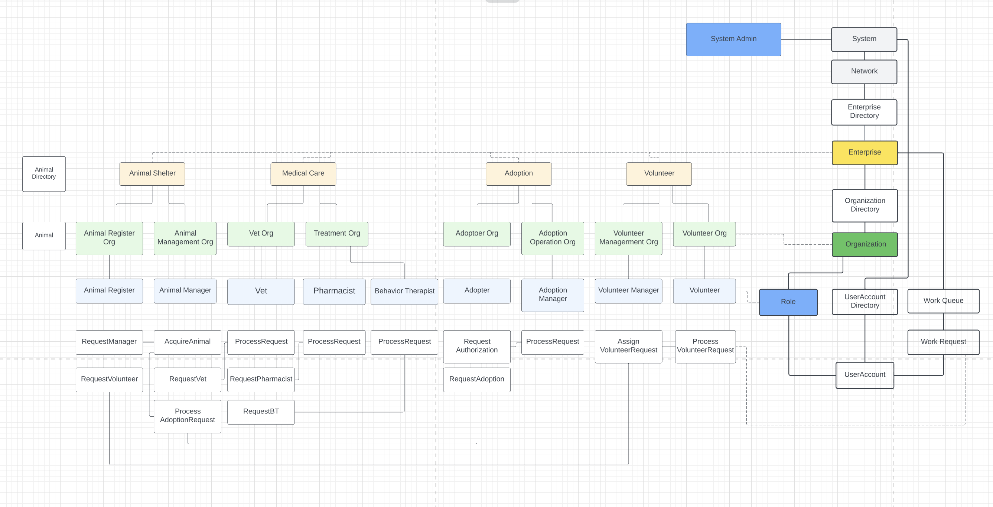
UML model

Slide 6
Advance Feature
Email
Service overview

Slide 7
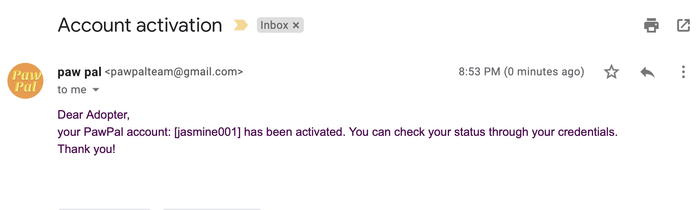
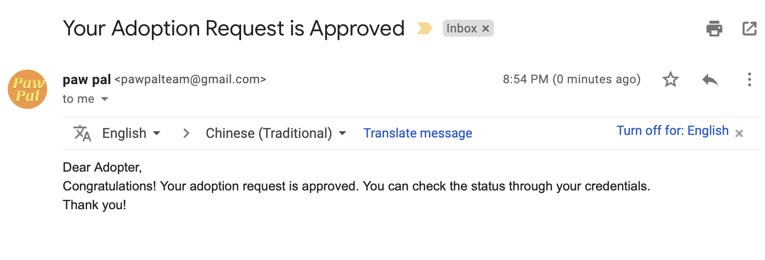
Advance Feature: e-mail

Slide 8
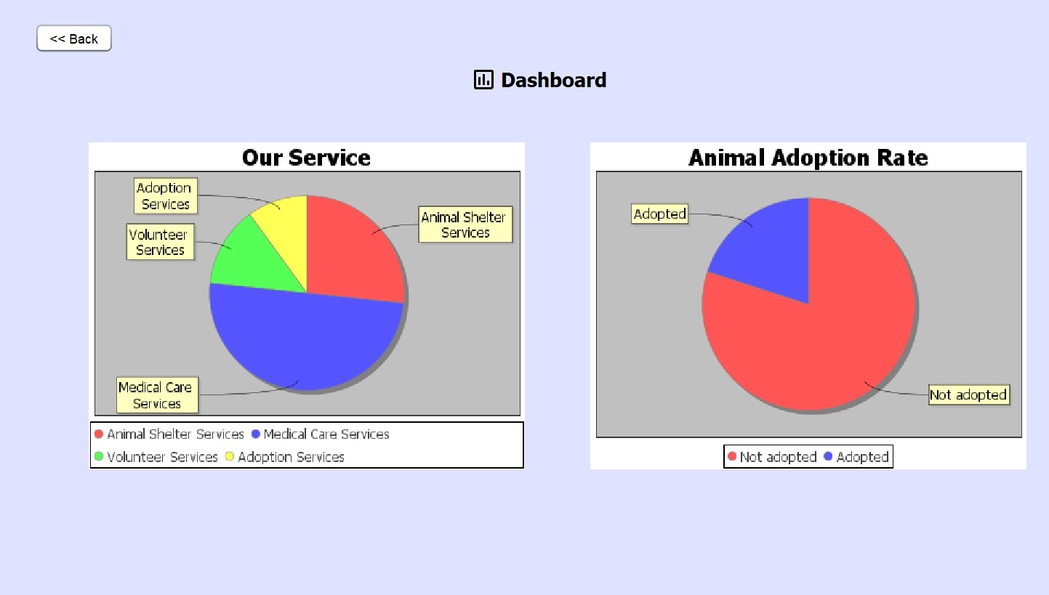
Advance Feature: service overview

Slide 9

System Admin: service structure
Network
Enterprise
Organization
User

Slide 10
System Admin
Admin: Populate the structure

Slide 11
Enterprises and Organizations

Slide 12
Animal Shelter
Animal register: add rescued animal into system
Animal manager: take total responsibility of an animal
Animal register: add rescued animal into system, request volunteer
Animal manager: take total responsibility of an animal

Slide 13

Medical Care
Vet Organization: serve as an animal's family doctor, do first step check
Treatment Organization: Pharmacy, give additional treatment
Treatment Organization: Behavior therapist, do advance check

Slide 14
Adoption Enterprise
Adopter organization: the solo external user of the system, check status and requests
Adoption Operation Organization: approve adopter accounts

Slide 15
Volunteer Enterprise
Volunteer: get job and repot process
Volunteer manager: destinate volunteers to tasks

Slide 16
Use case Sequence

Slide 17
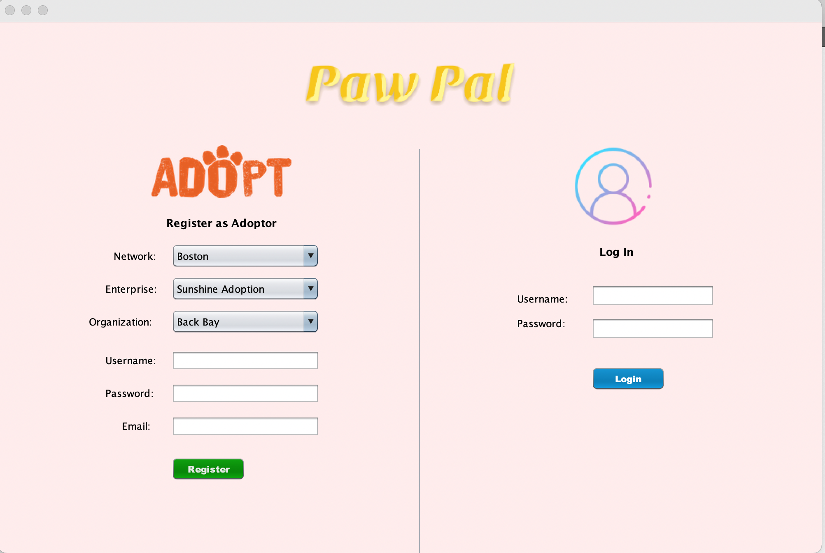
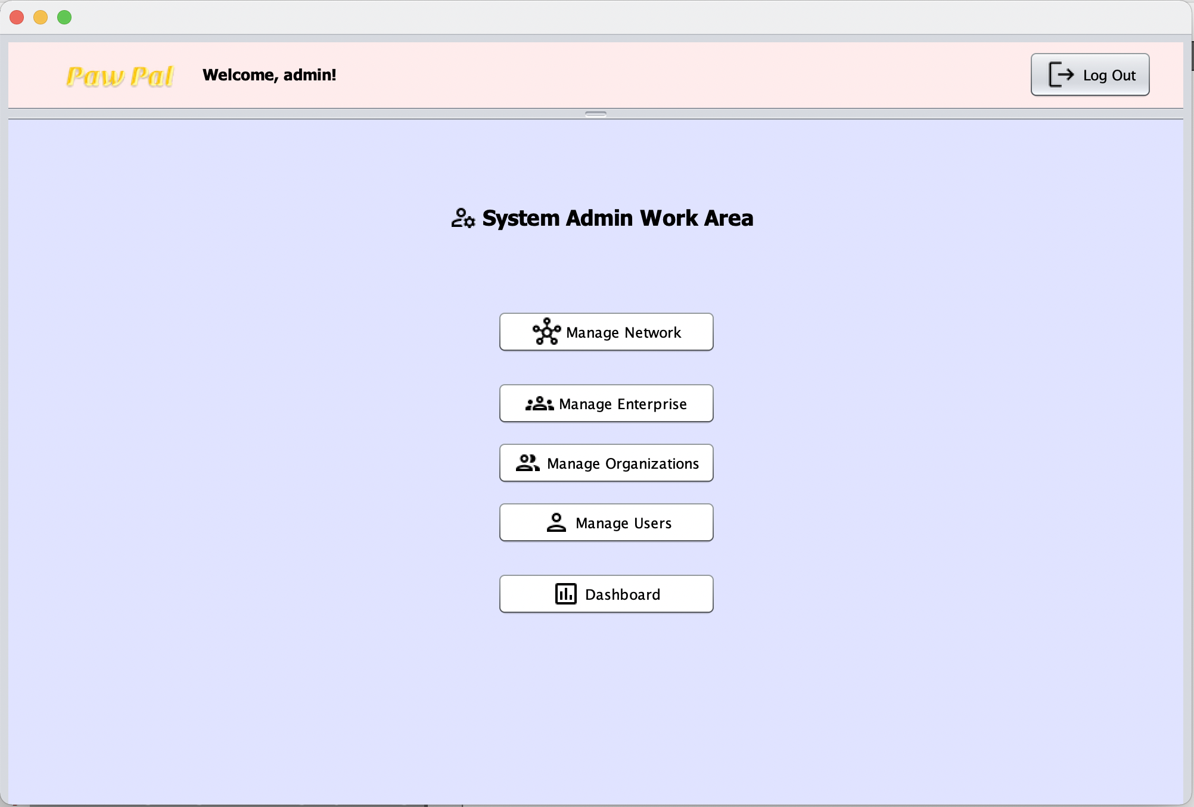
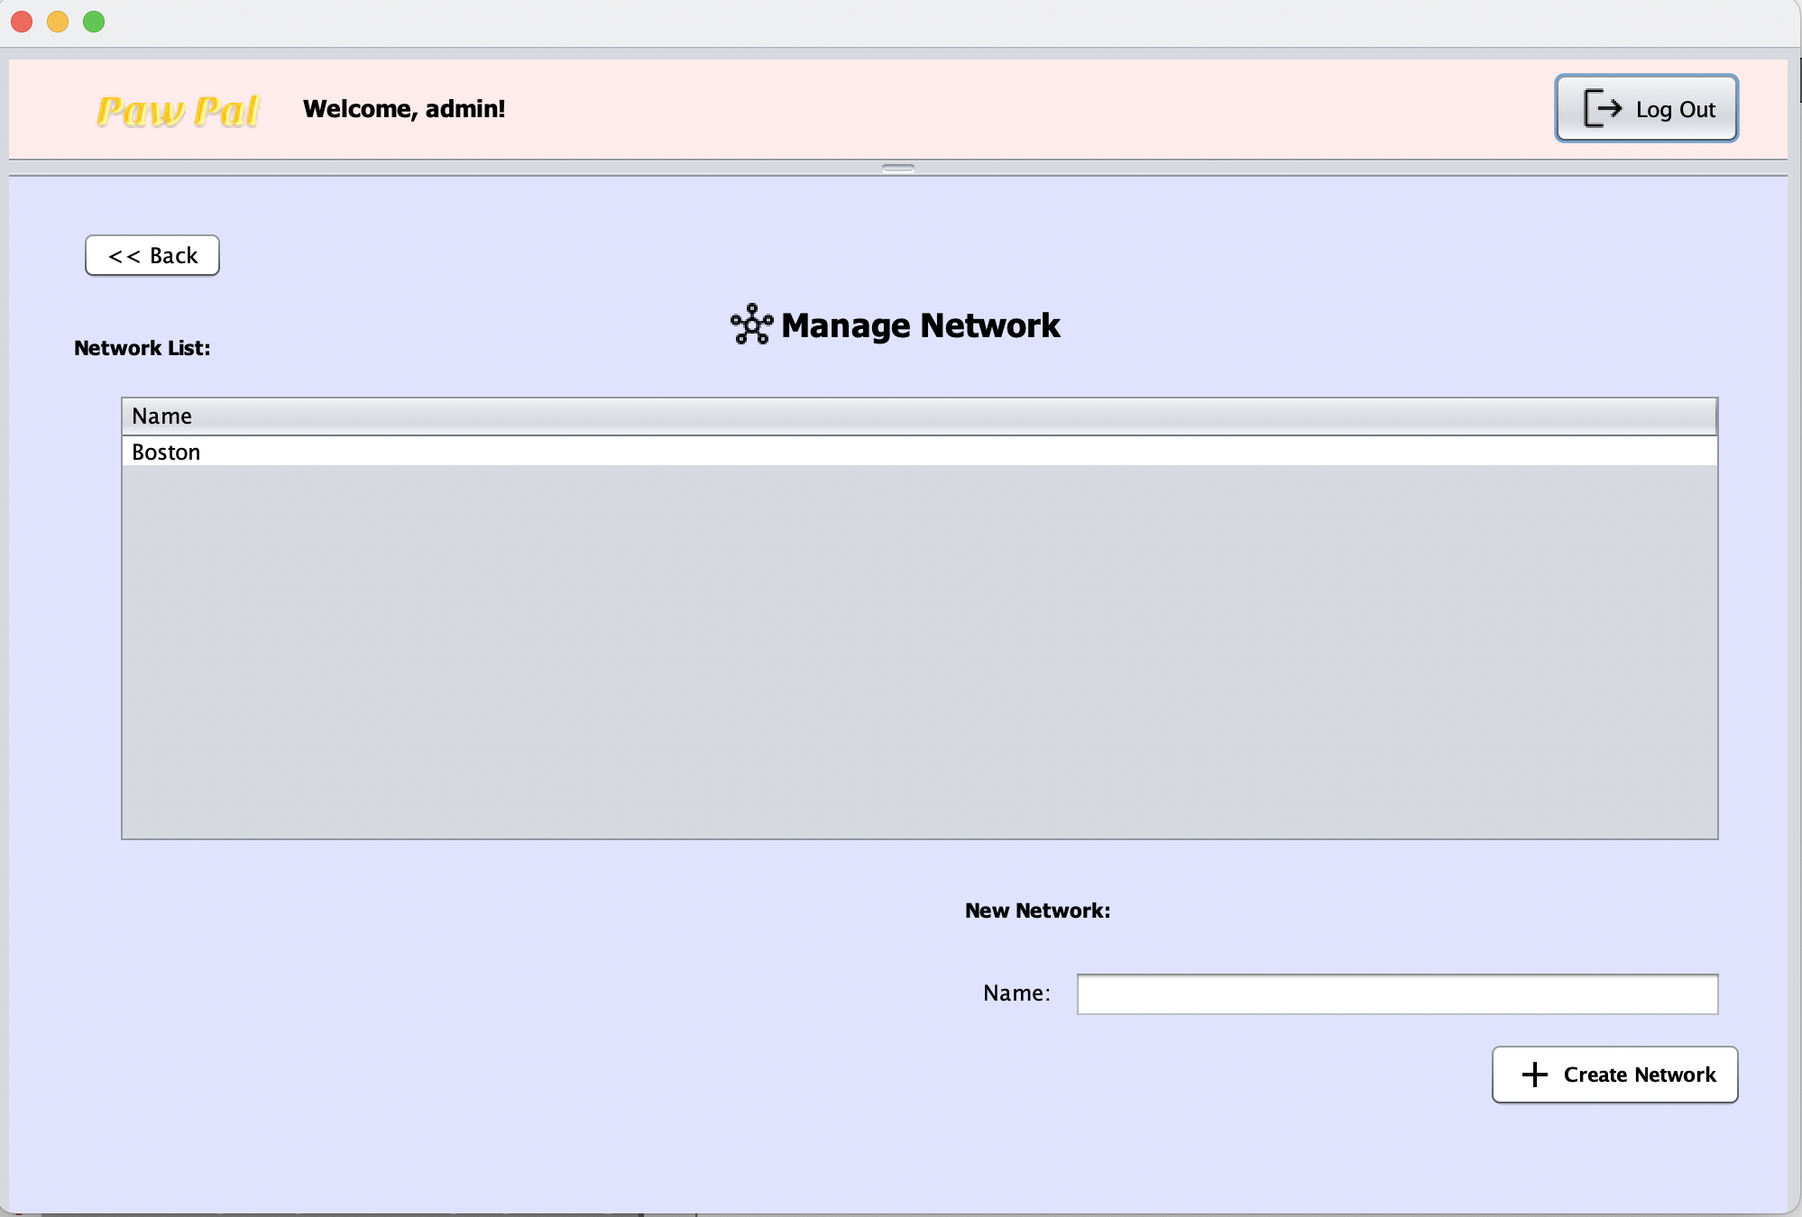
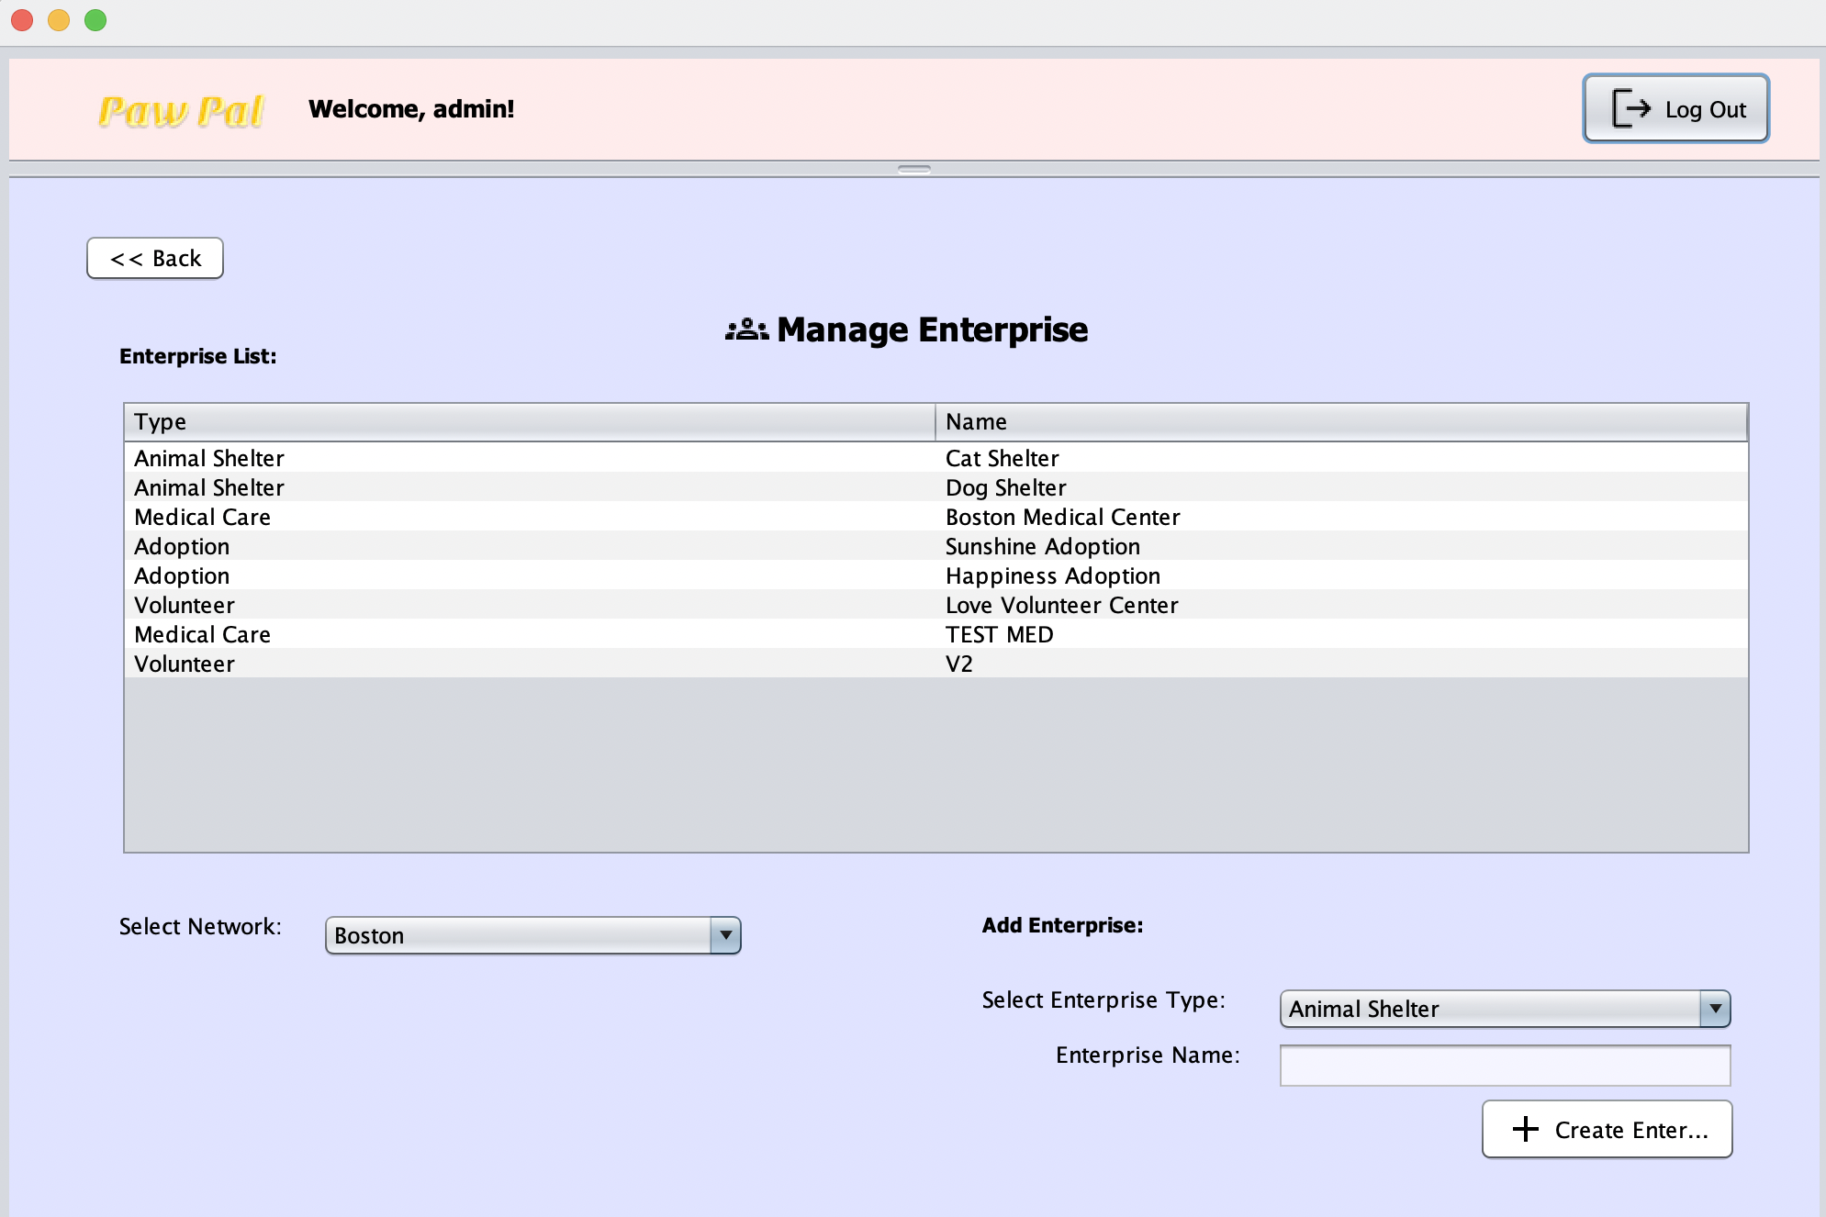
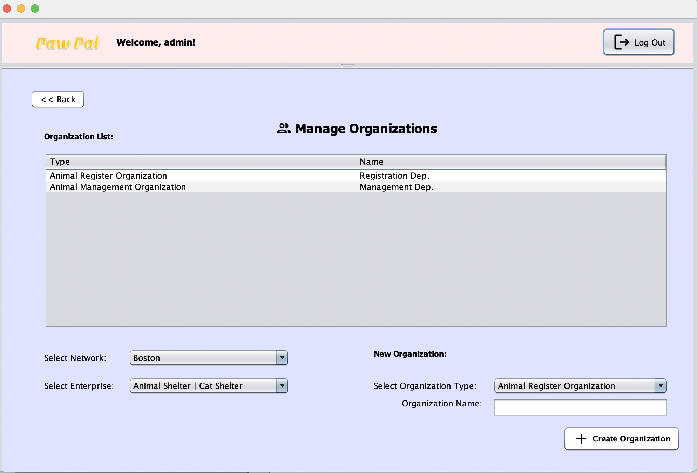
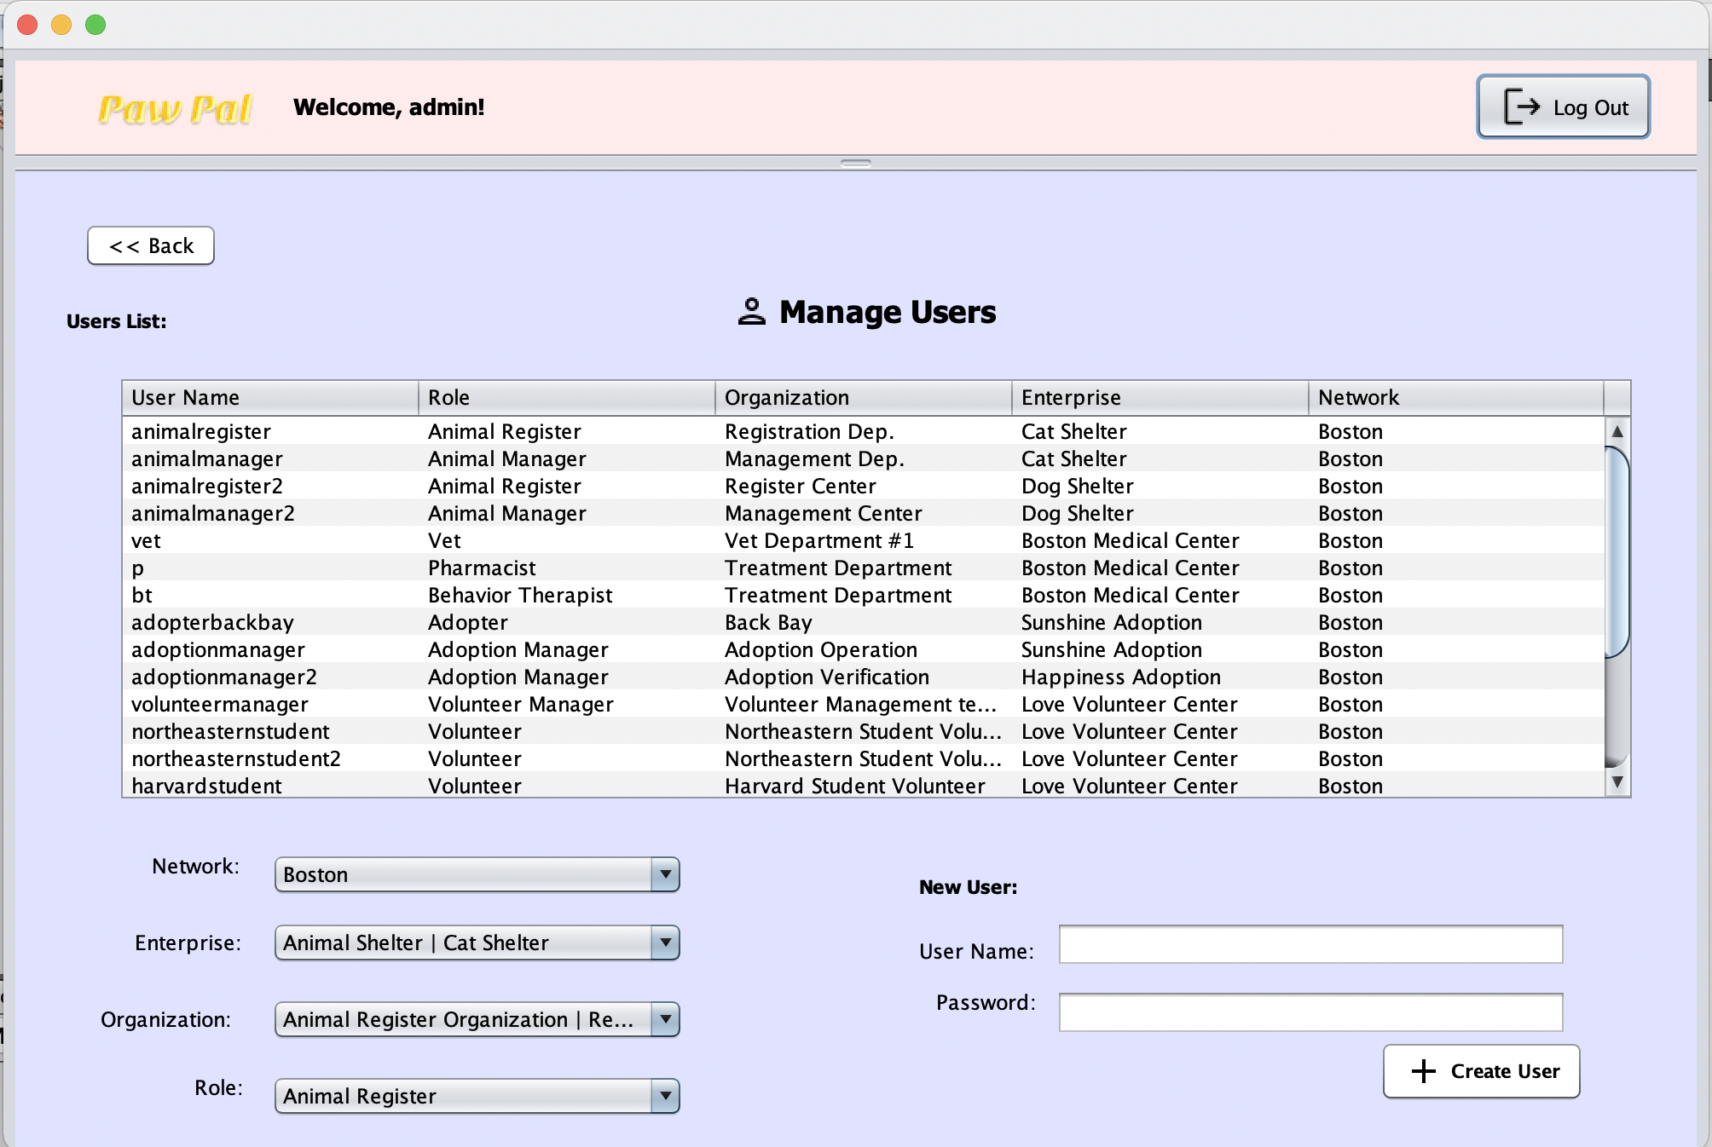
System Admin
Log In
Choose task
Create Network
Create Enterprise
Create Organization
Create user

Slide 18
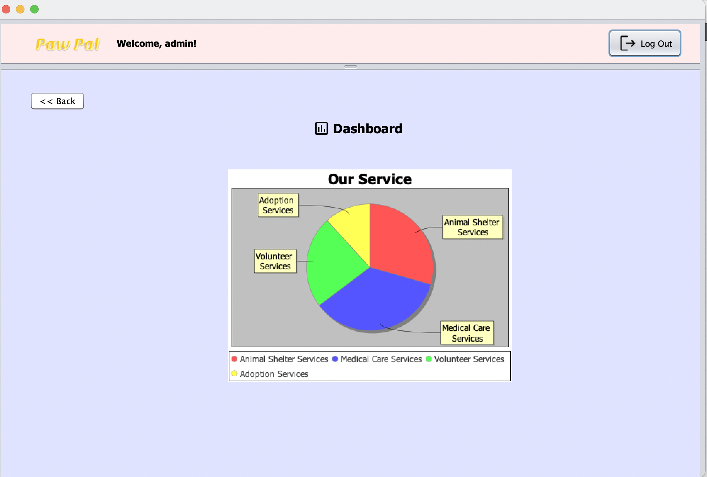
System Admin
Log In
Choose task
View Dashboard

Slide 19
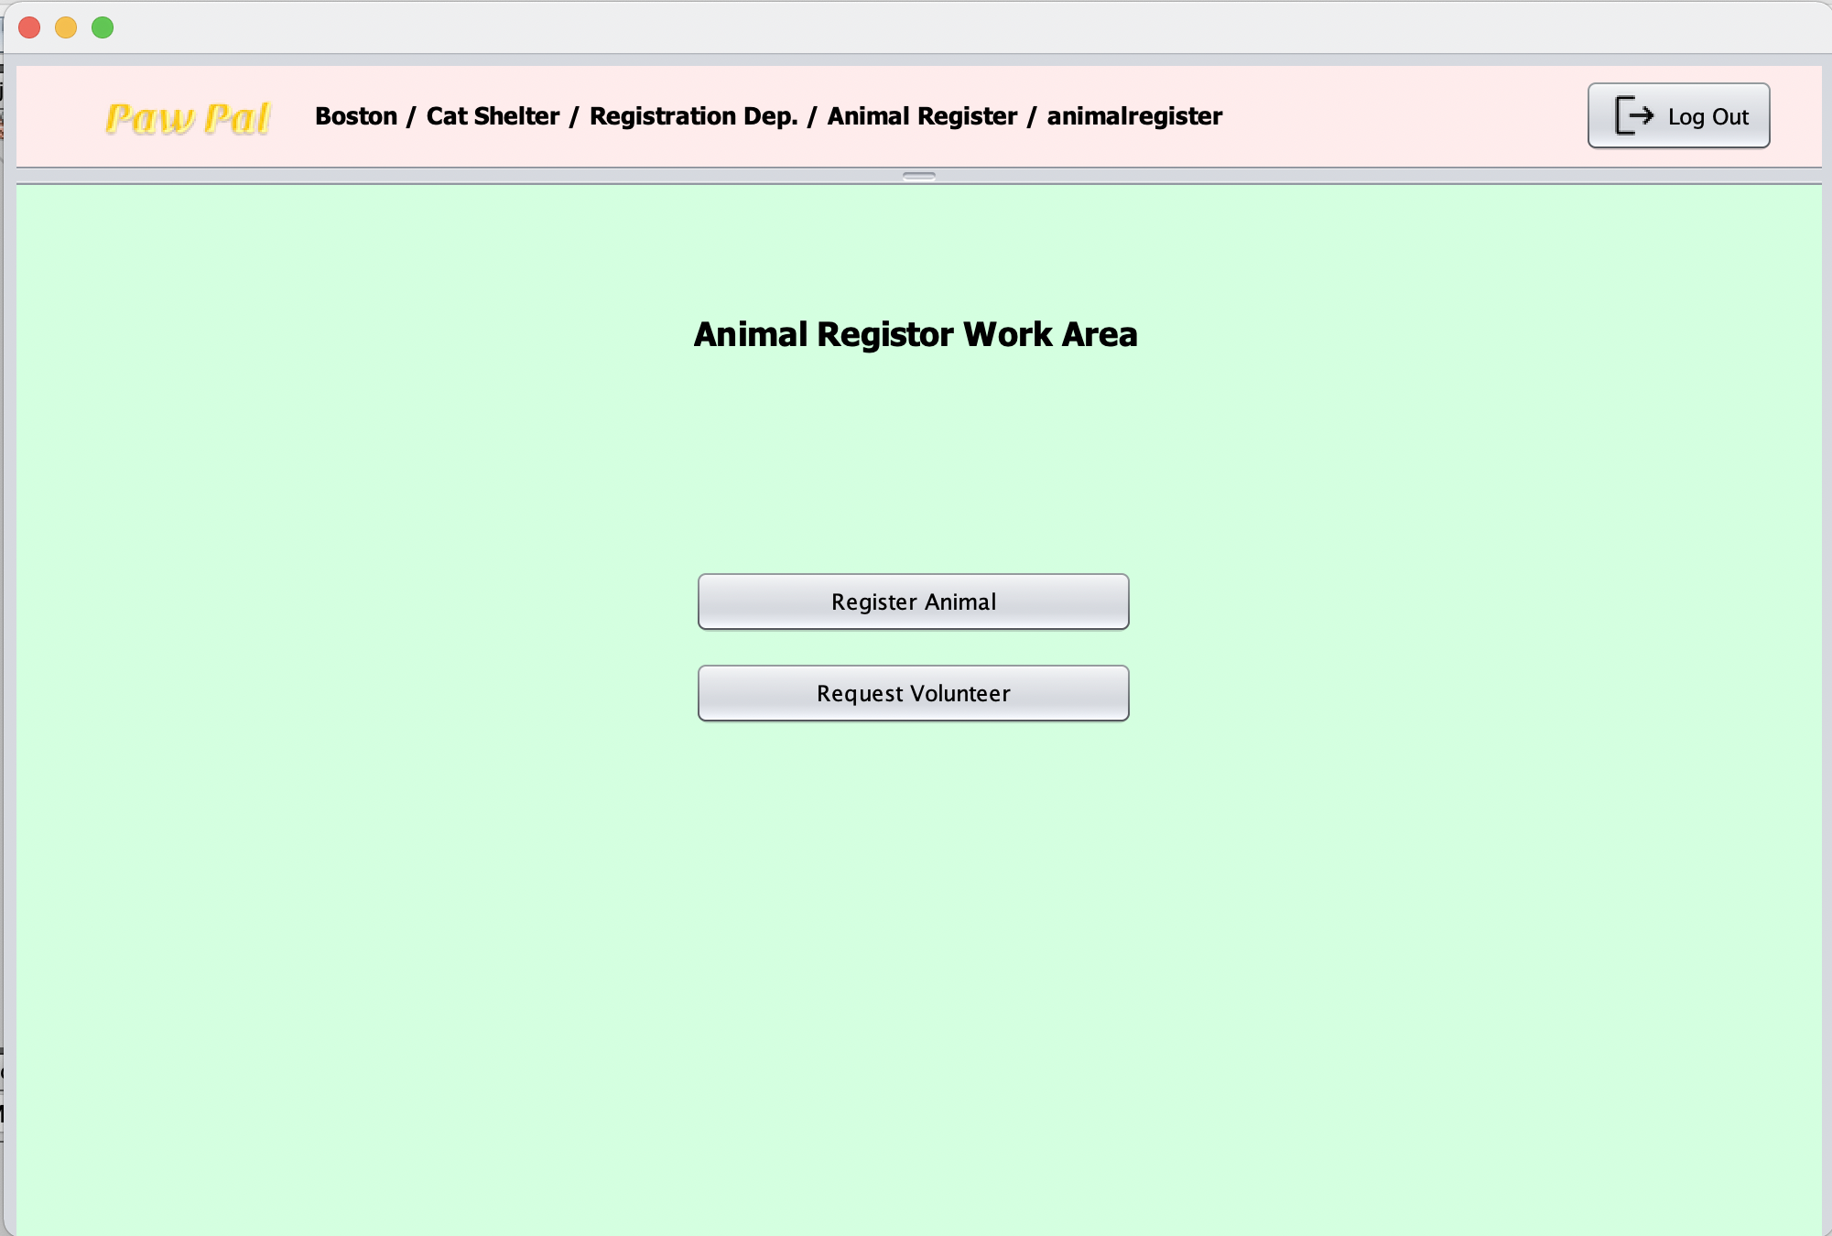
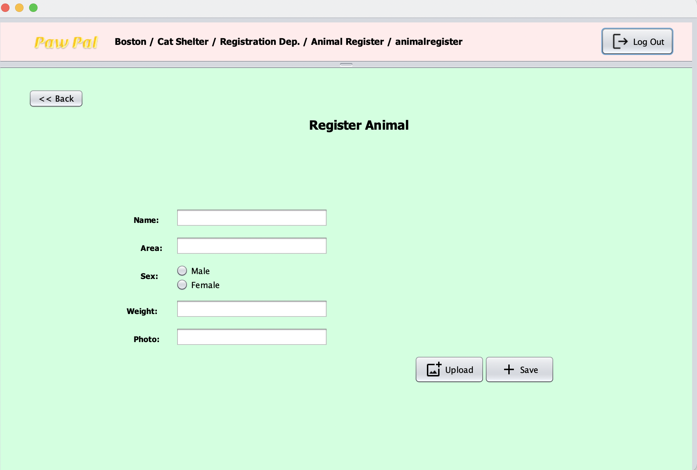
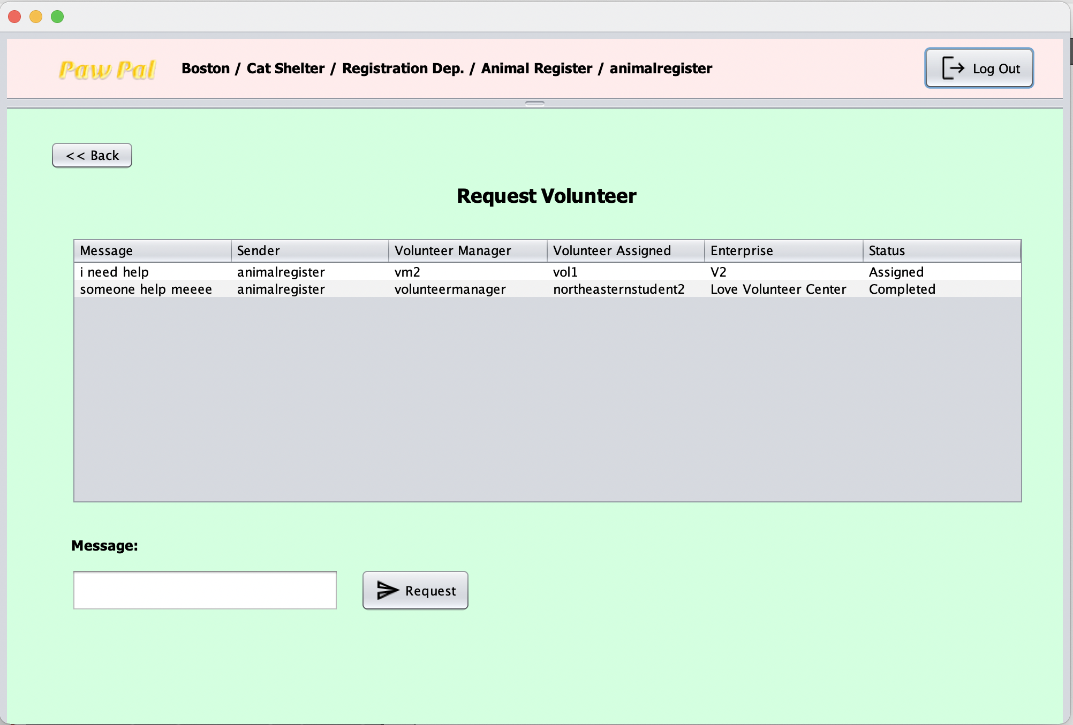
Animal Register
Log In
Choose task
Register Animal
Request Volunteer

Slide 20
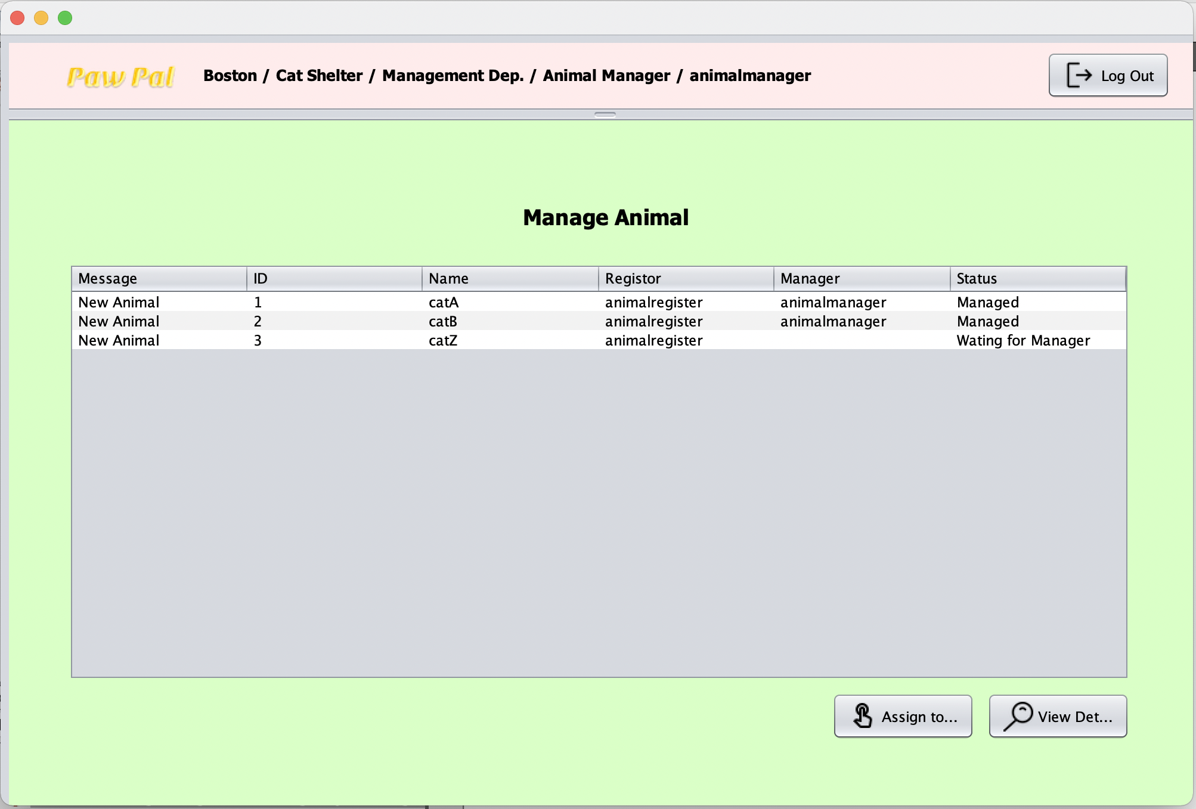
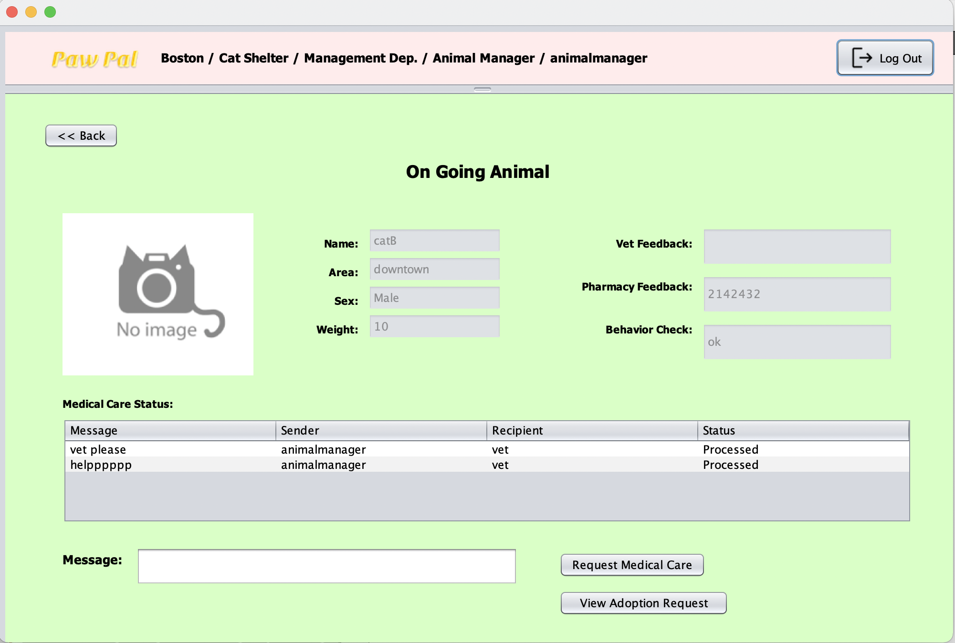
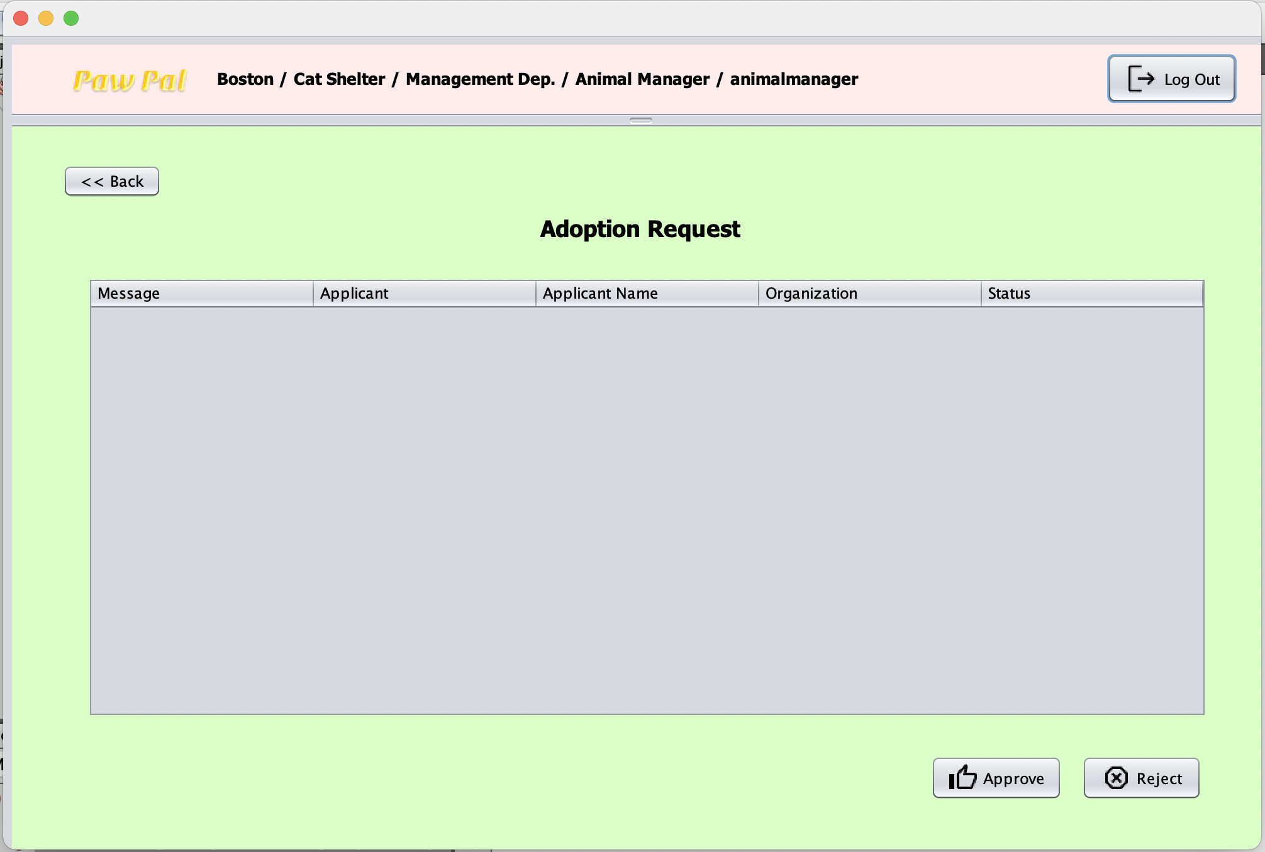
Animal Manager
Log In
Manage Animal
View Animal
Process adoption request

Slide 21
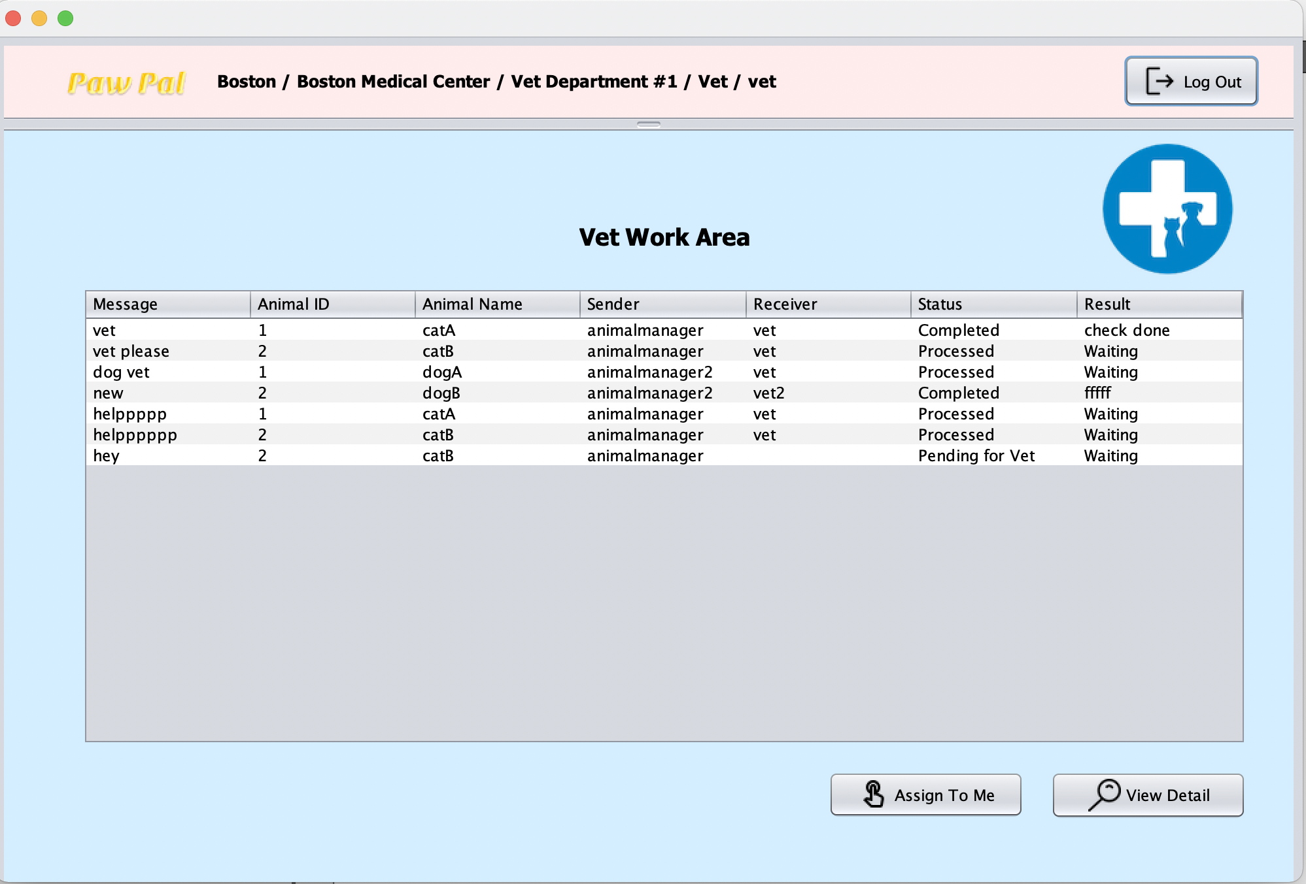
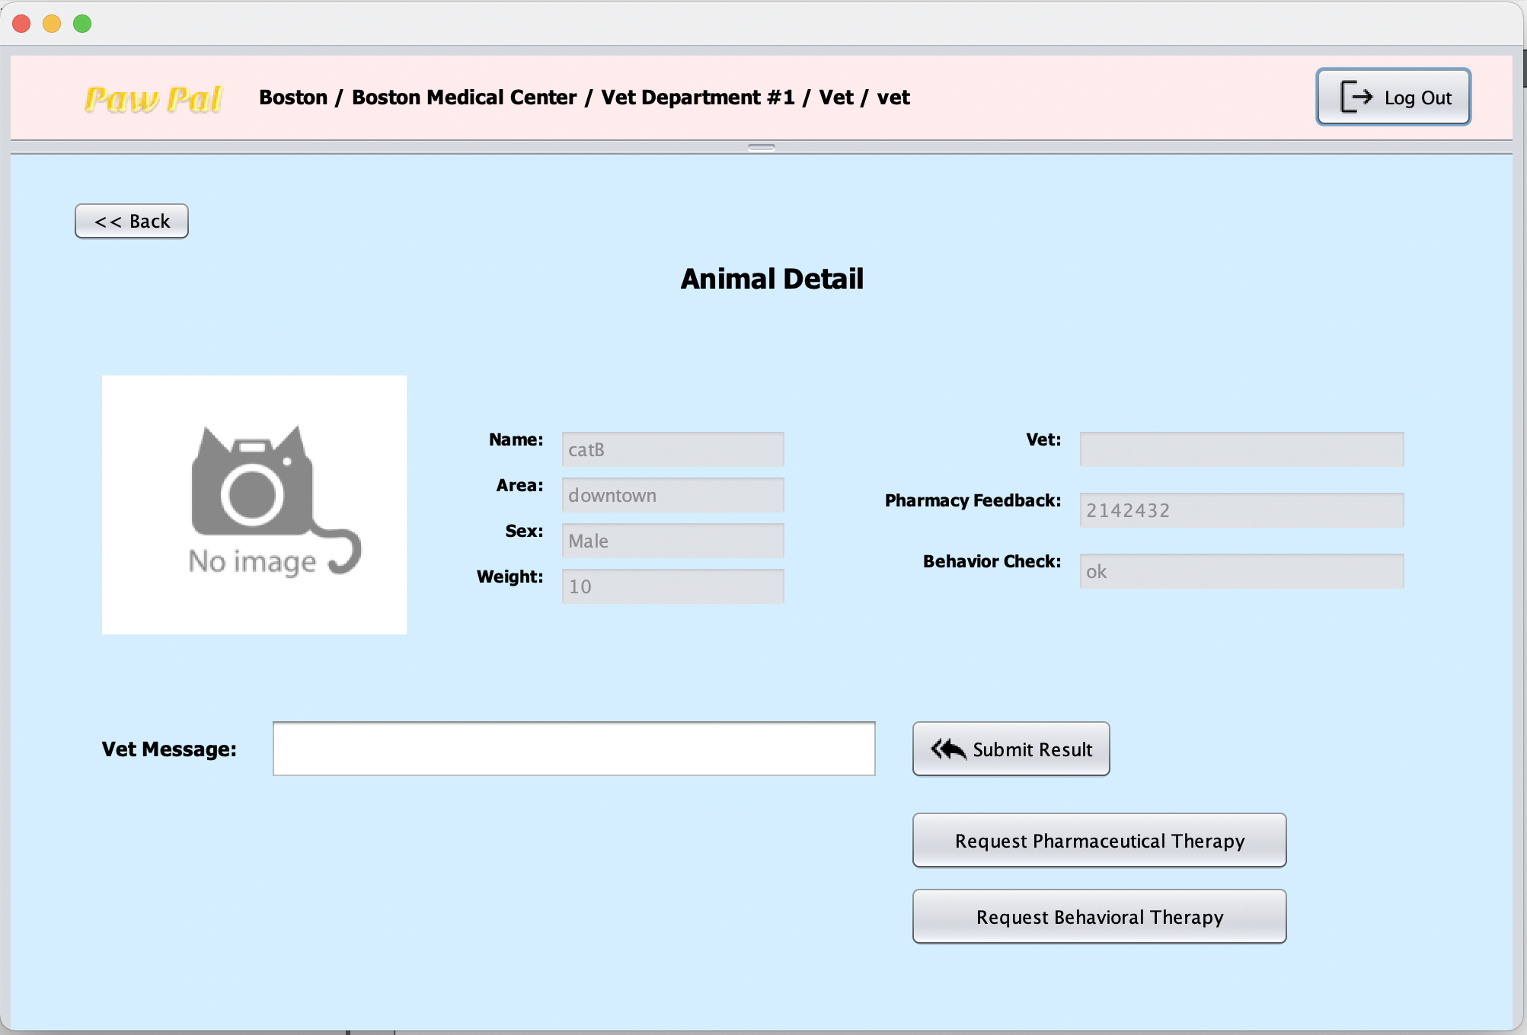
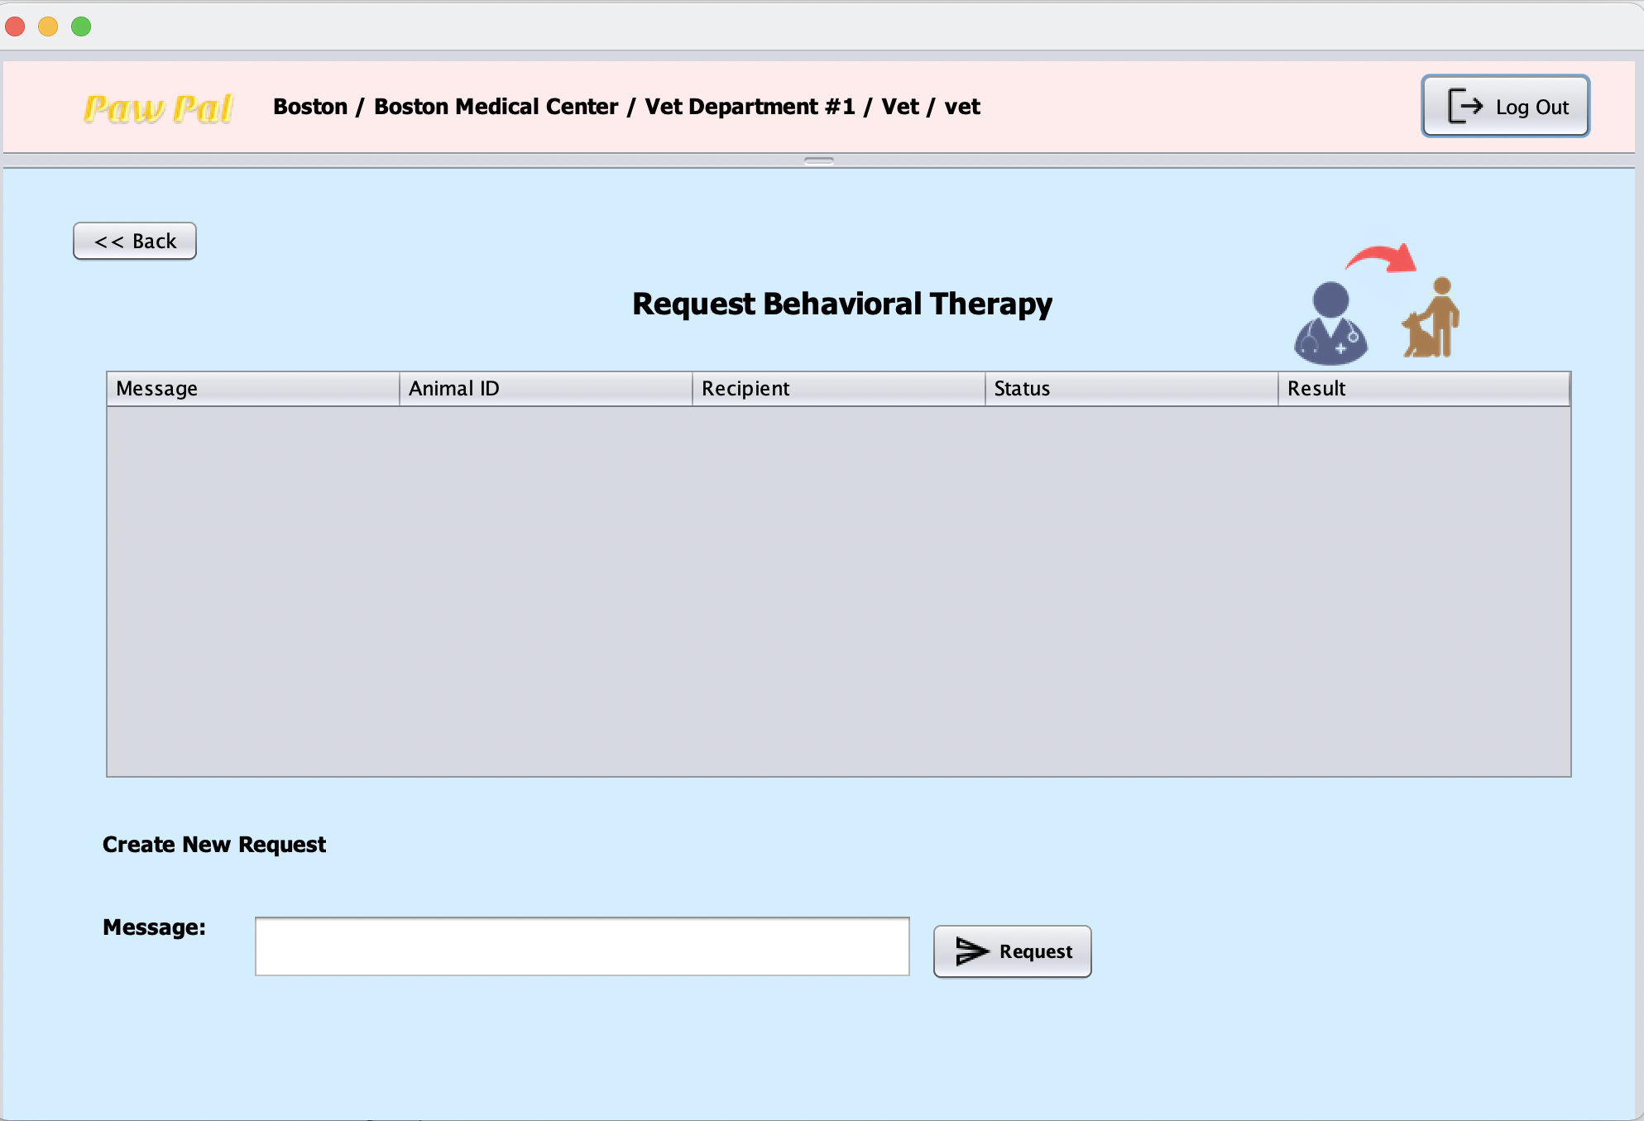
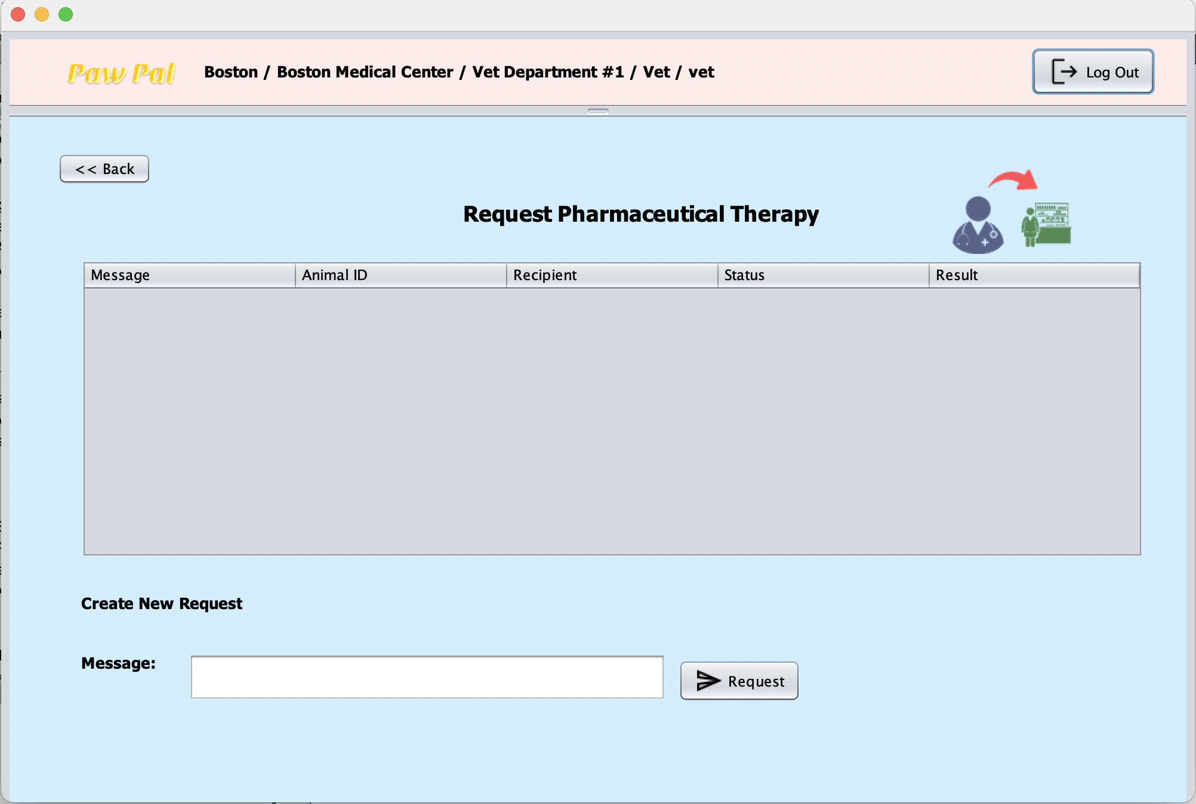
Vet
Log In
View Animal
View Detail
Request Behavior check
Request Pharmacy

Slide 22
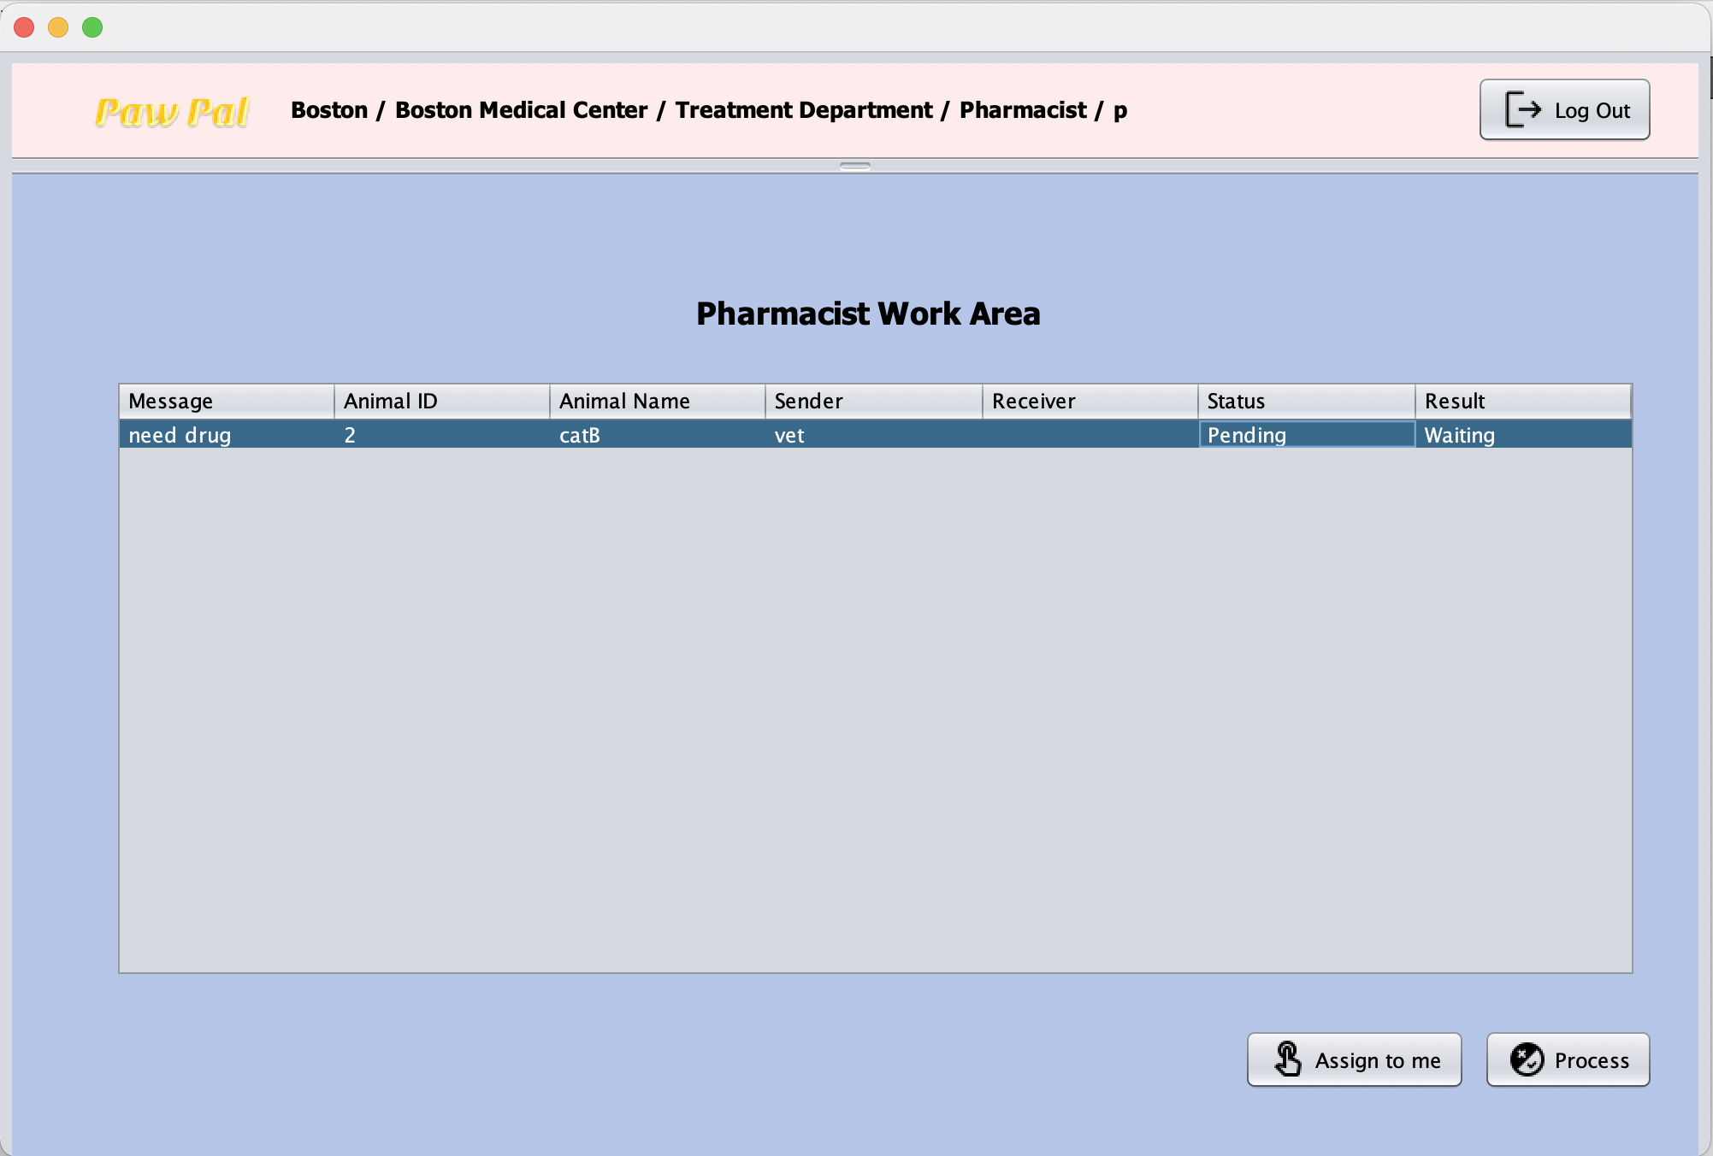
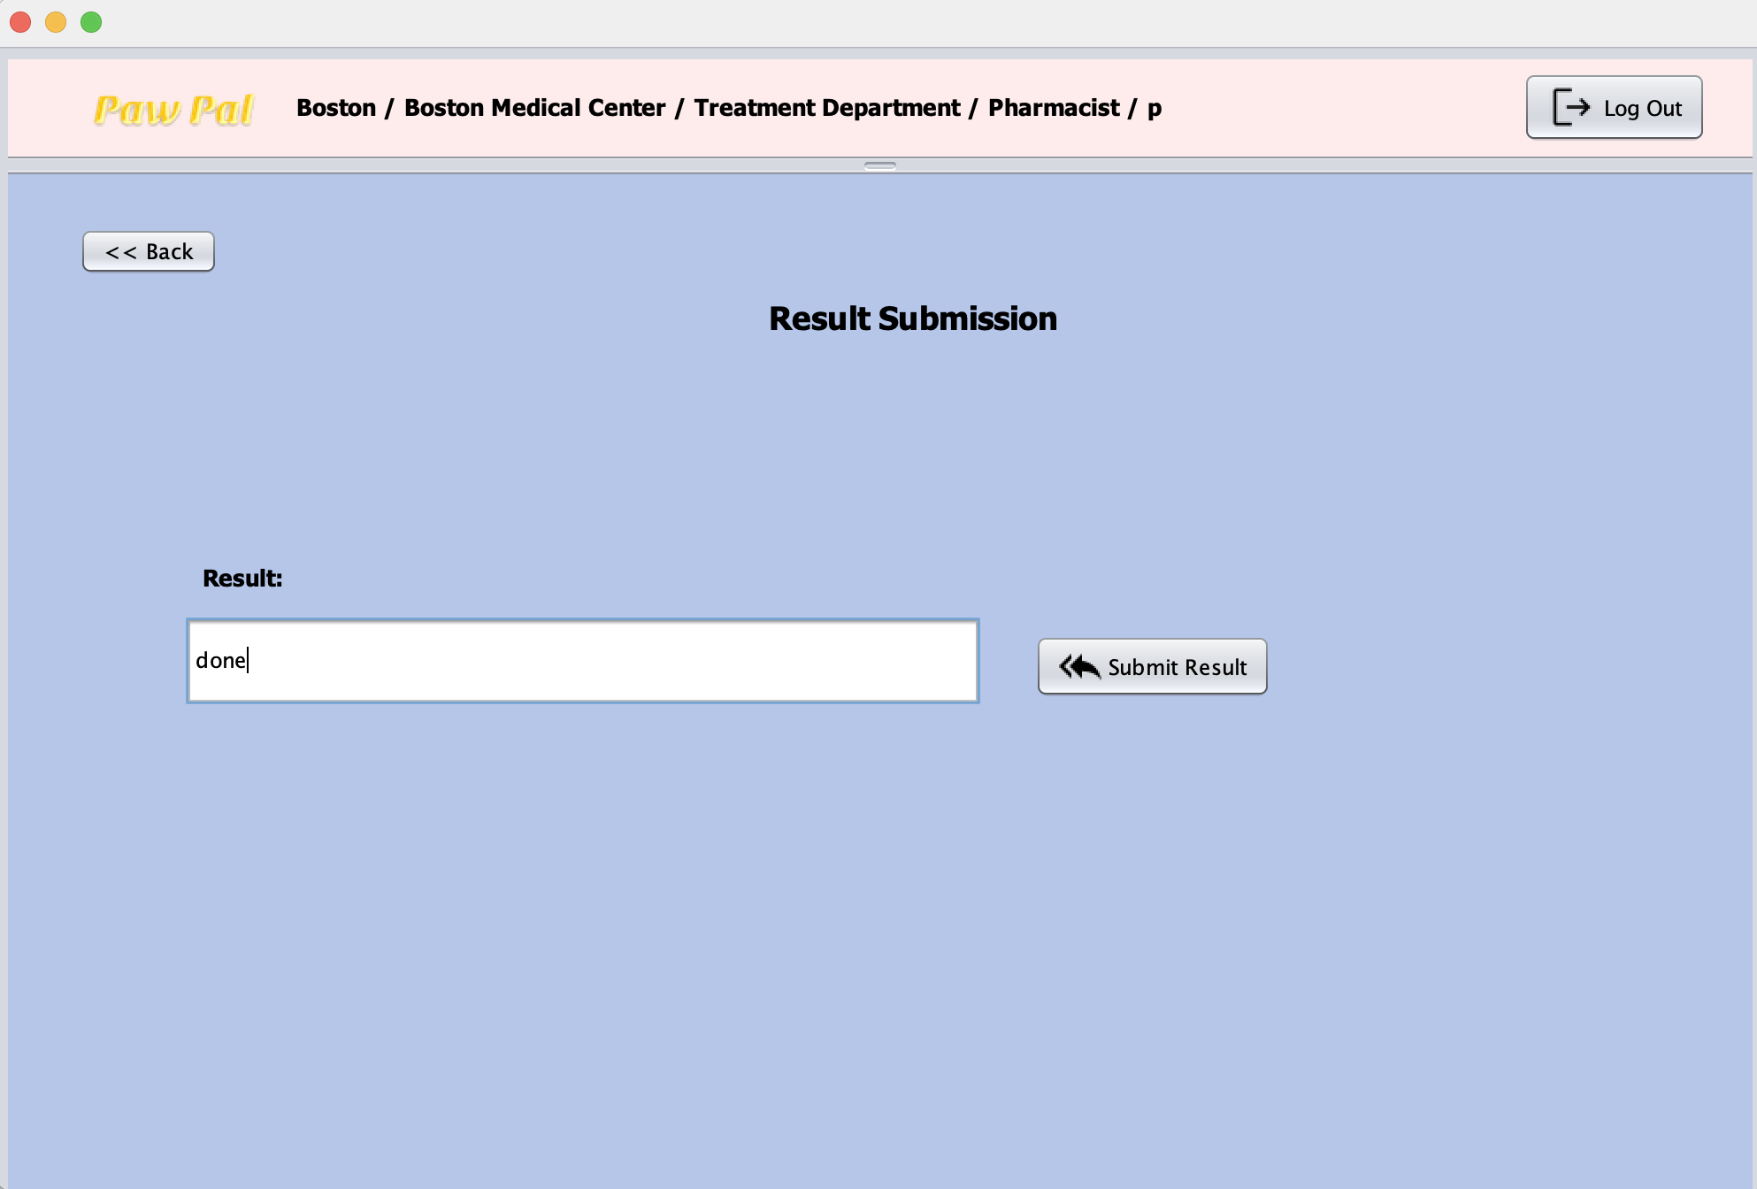
Pharmacy
Log In
View work/
Get a task
Process task

Slide 23
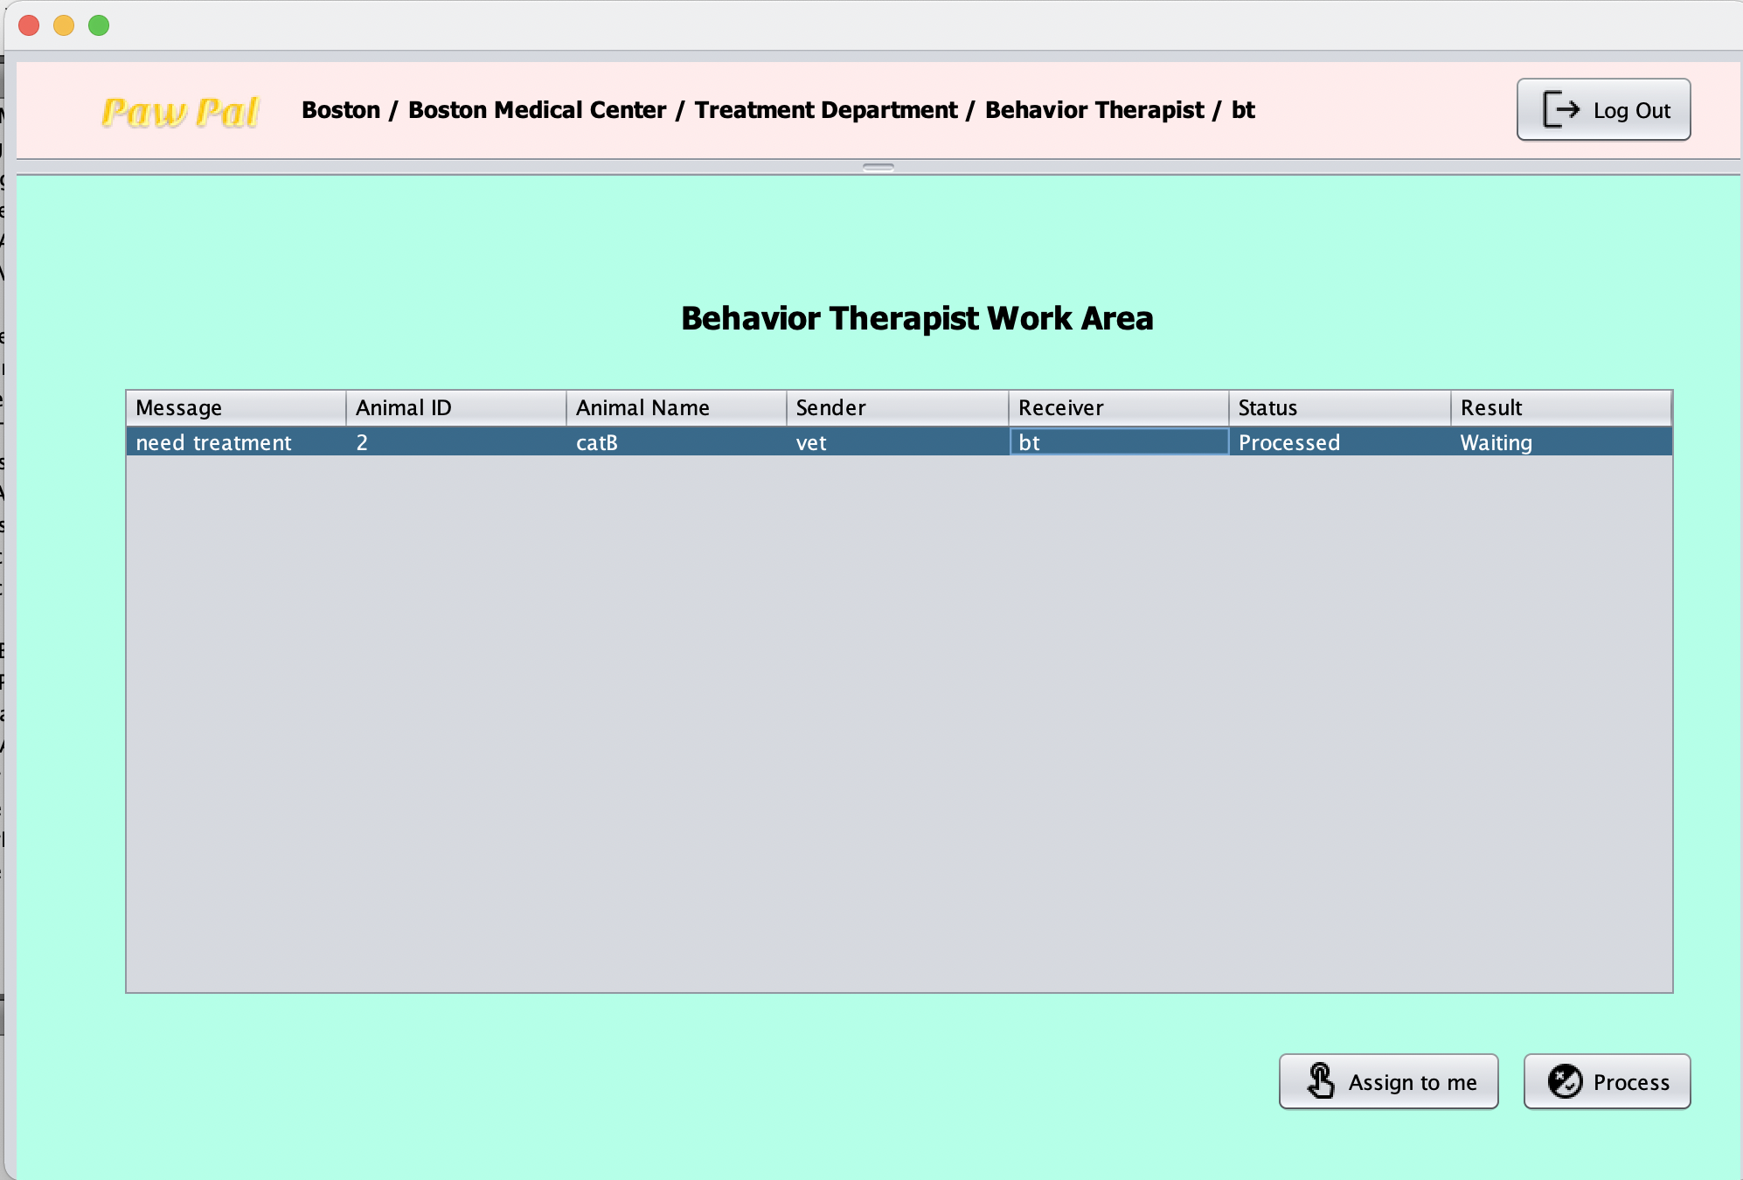
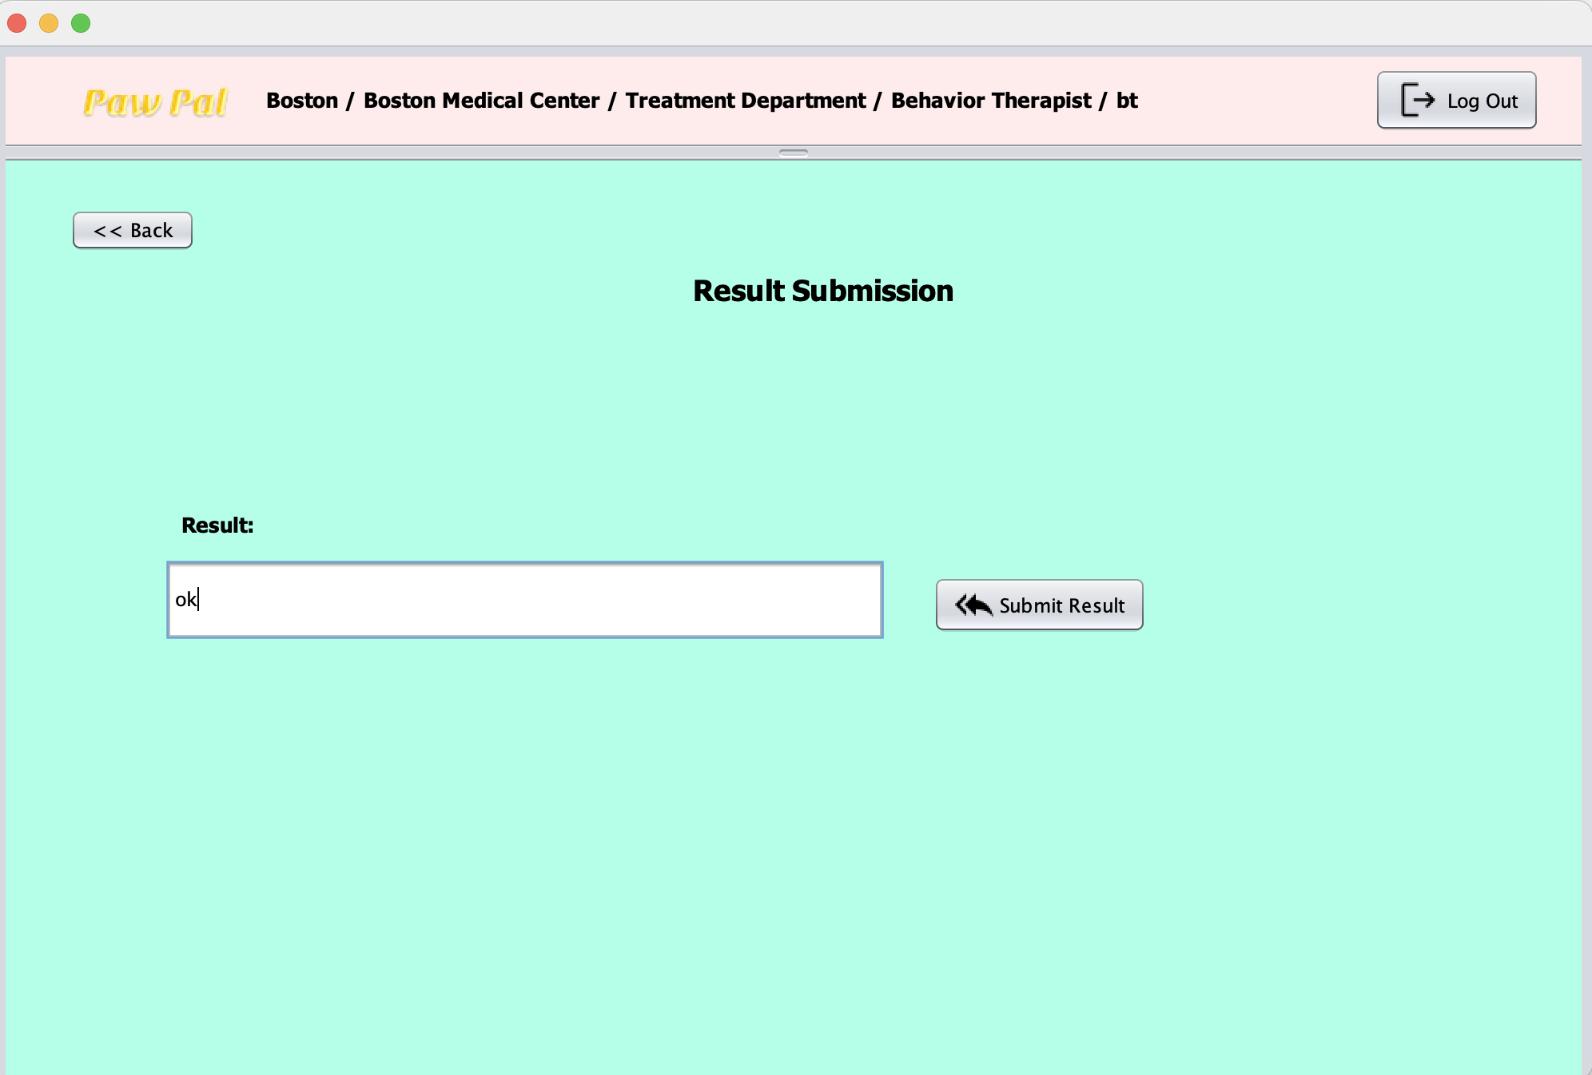
Behavior Therapist
Log In
View work/
Get a task
Process task

Slide 24
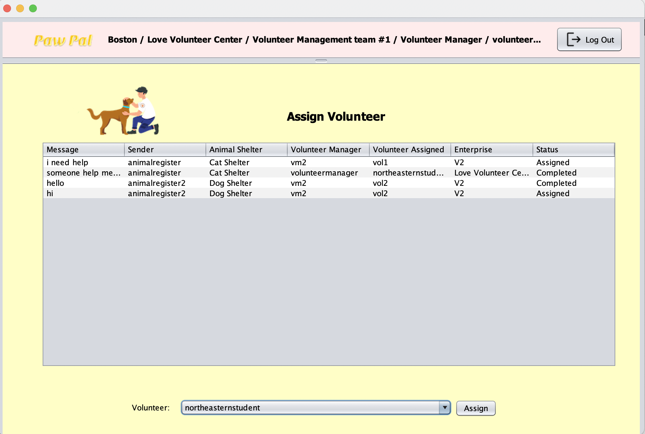
Volunteer Manager
Log In
Assing volunteer

Slide 25
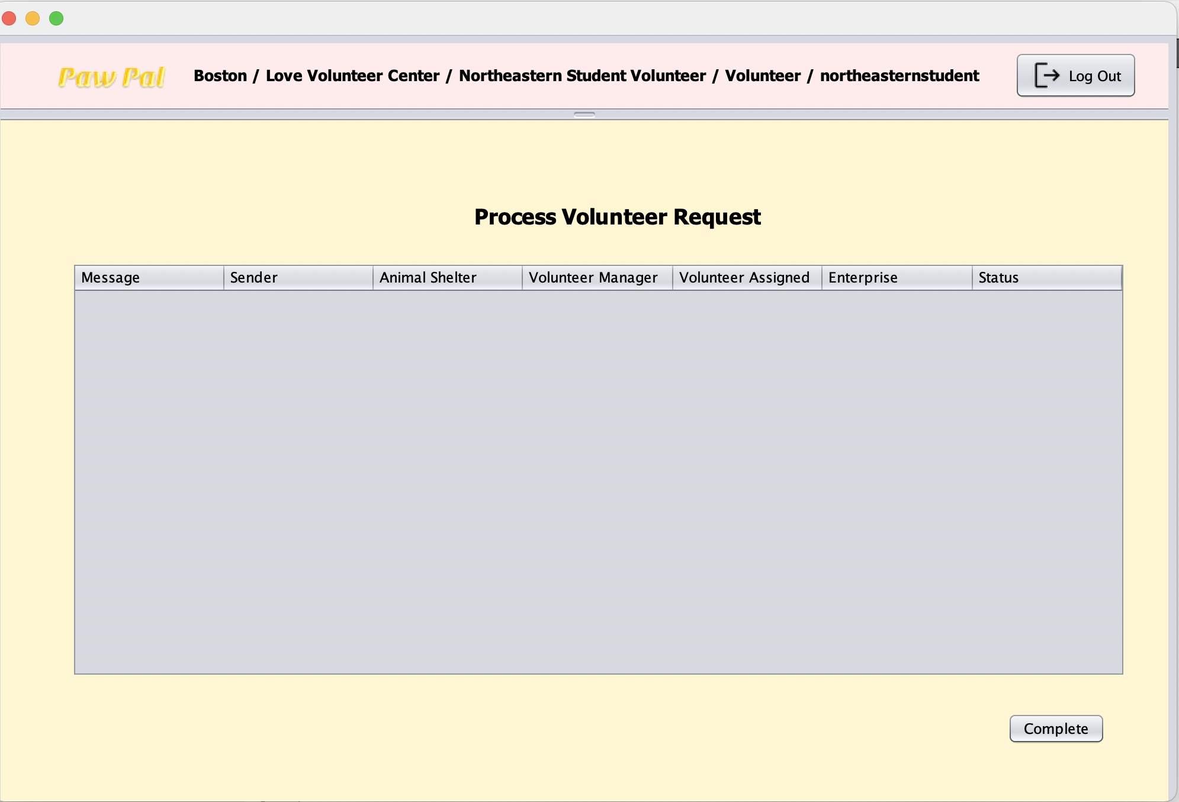
Volunteer
Log In
Report completed job

Slide 26
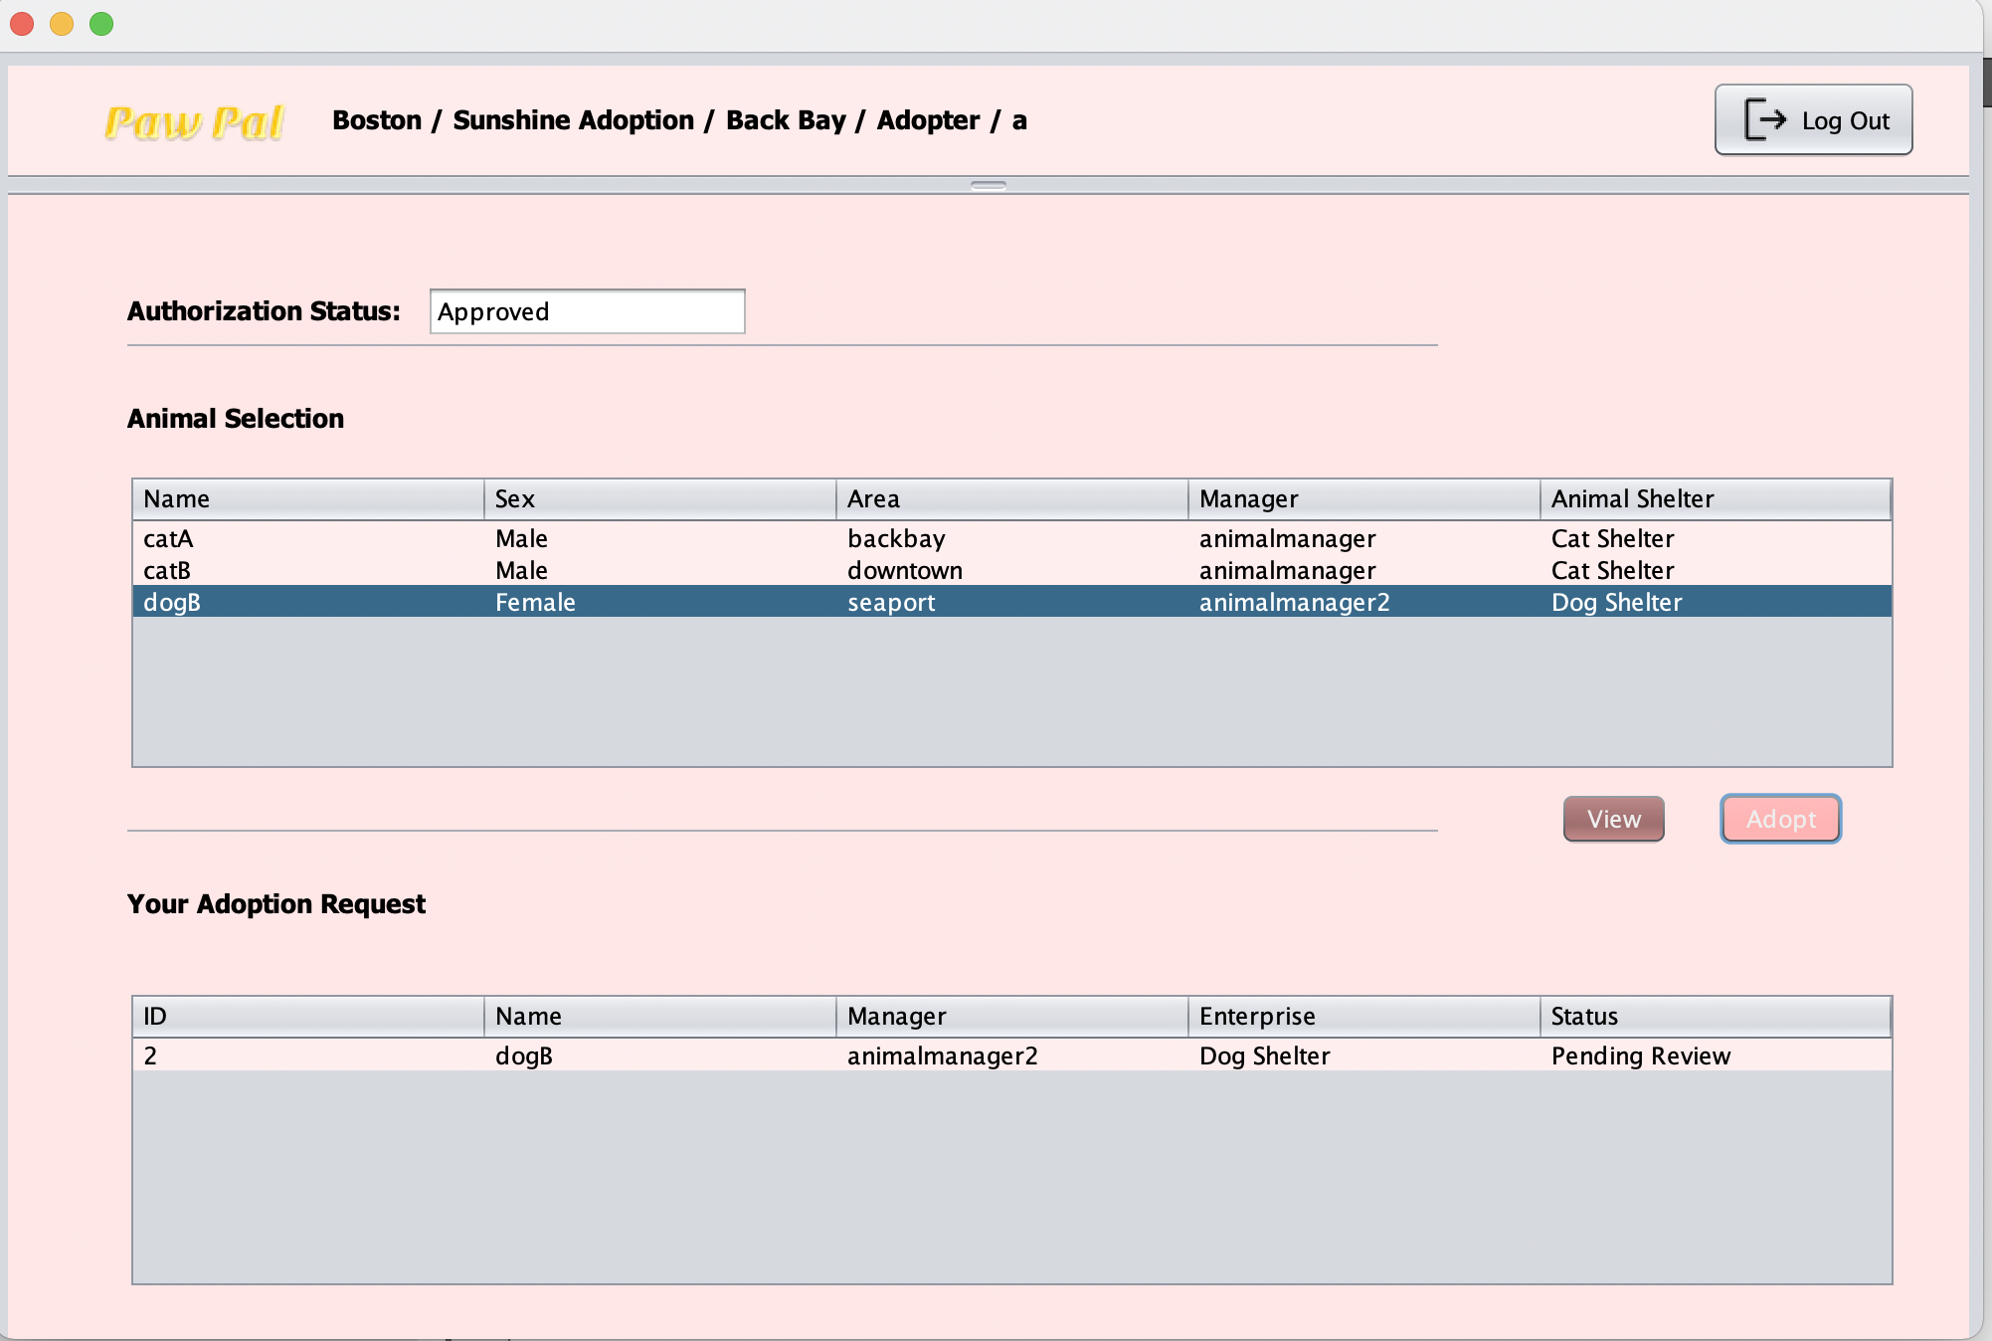
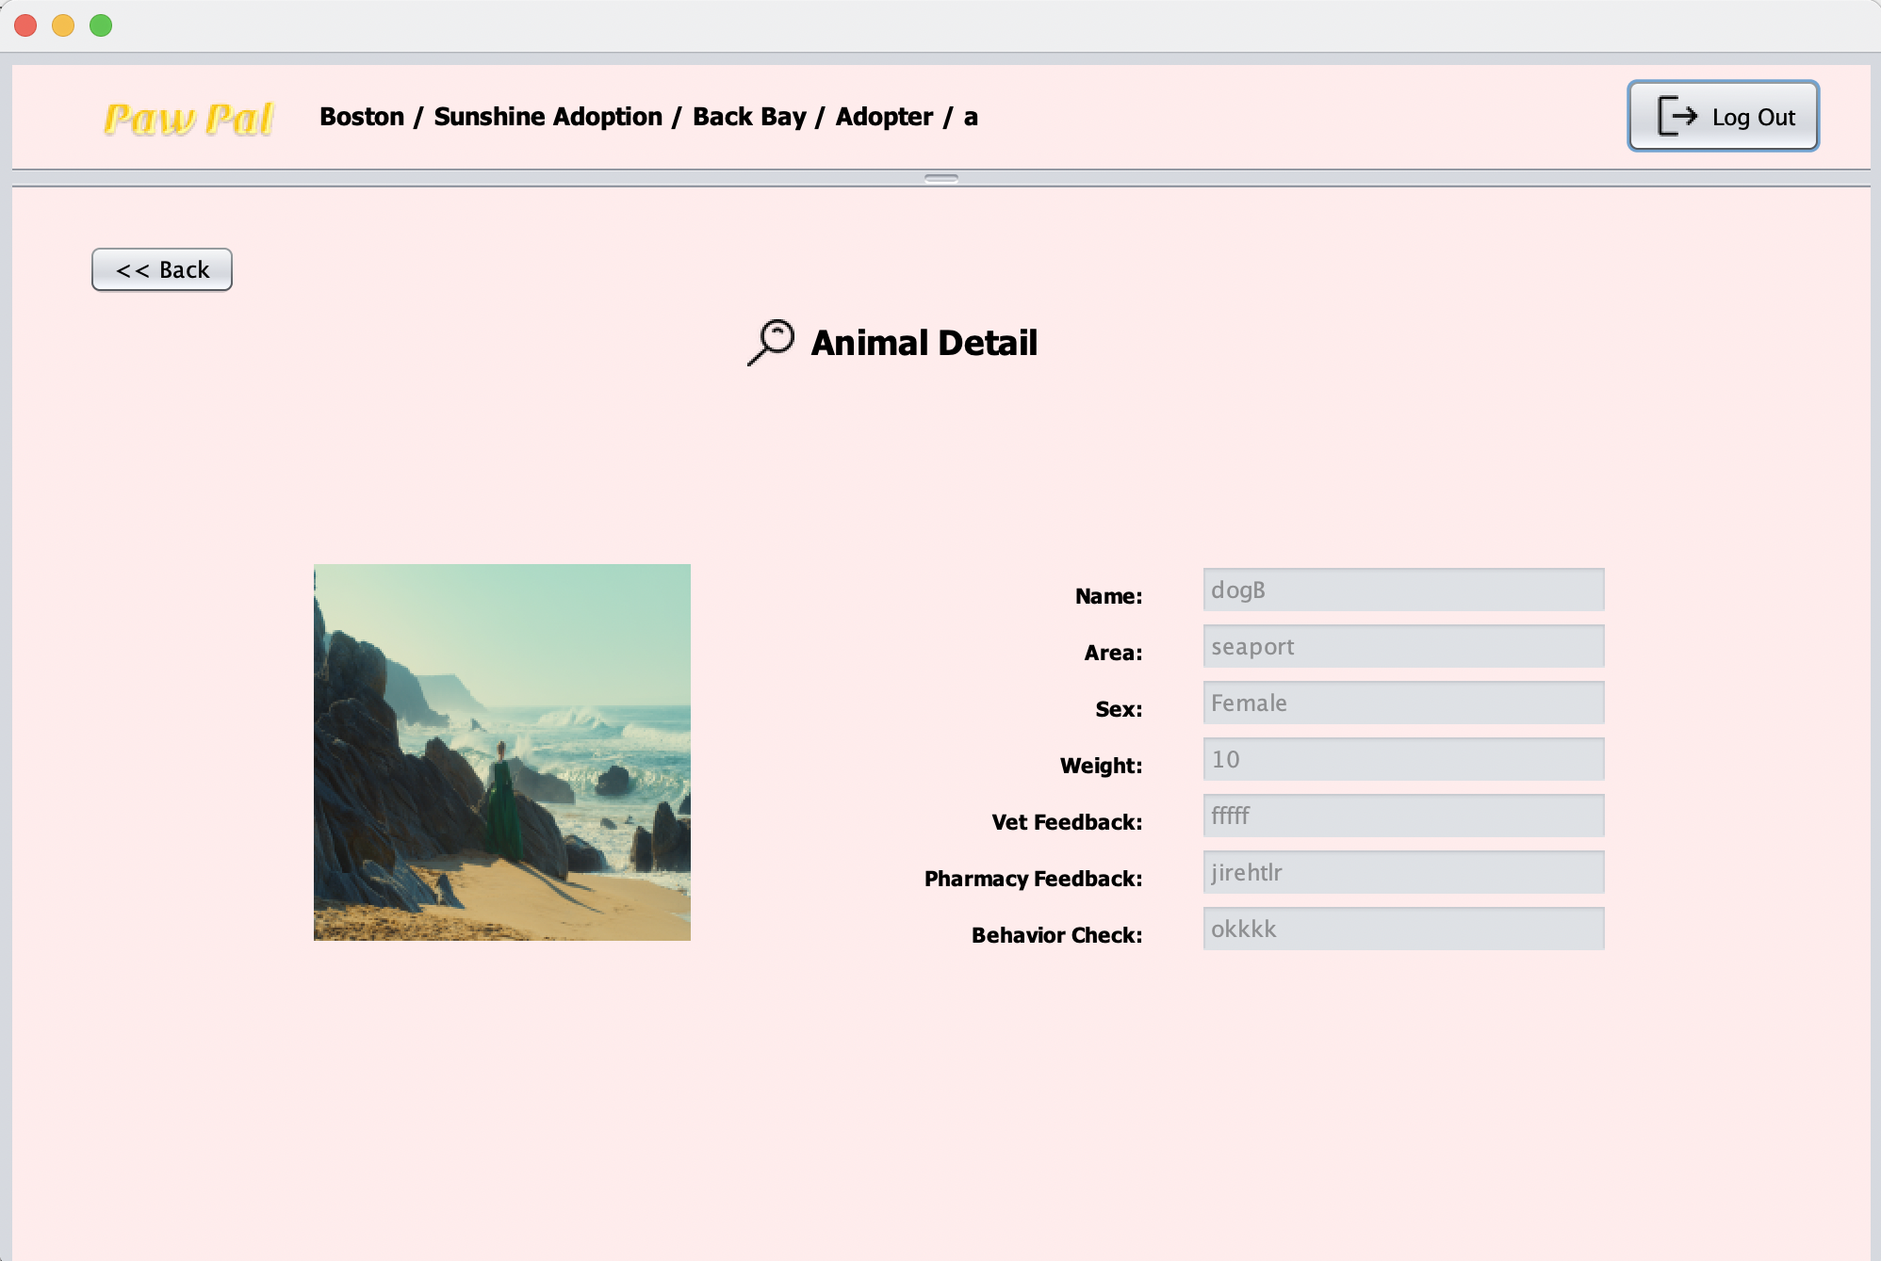
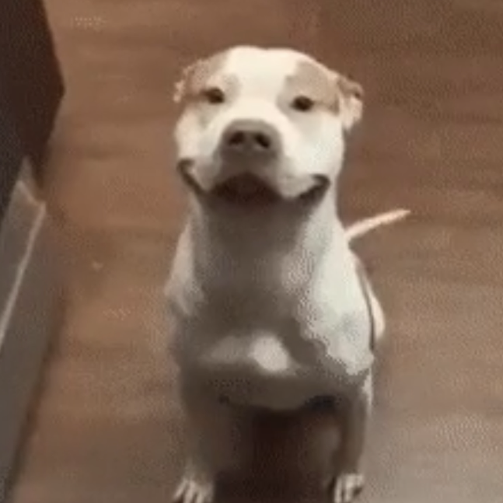
Adopter
Log In
Adoption request/
View request status
View Animal Detail

Slide 27
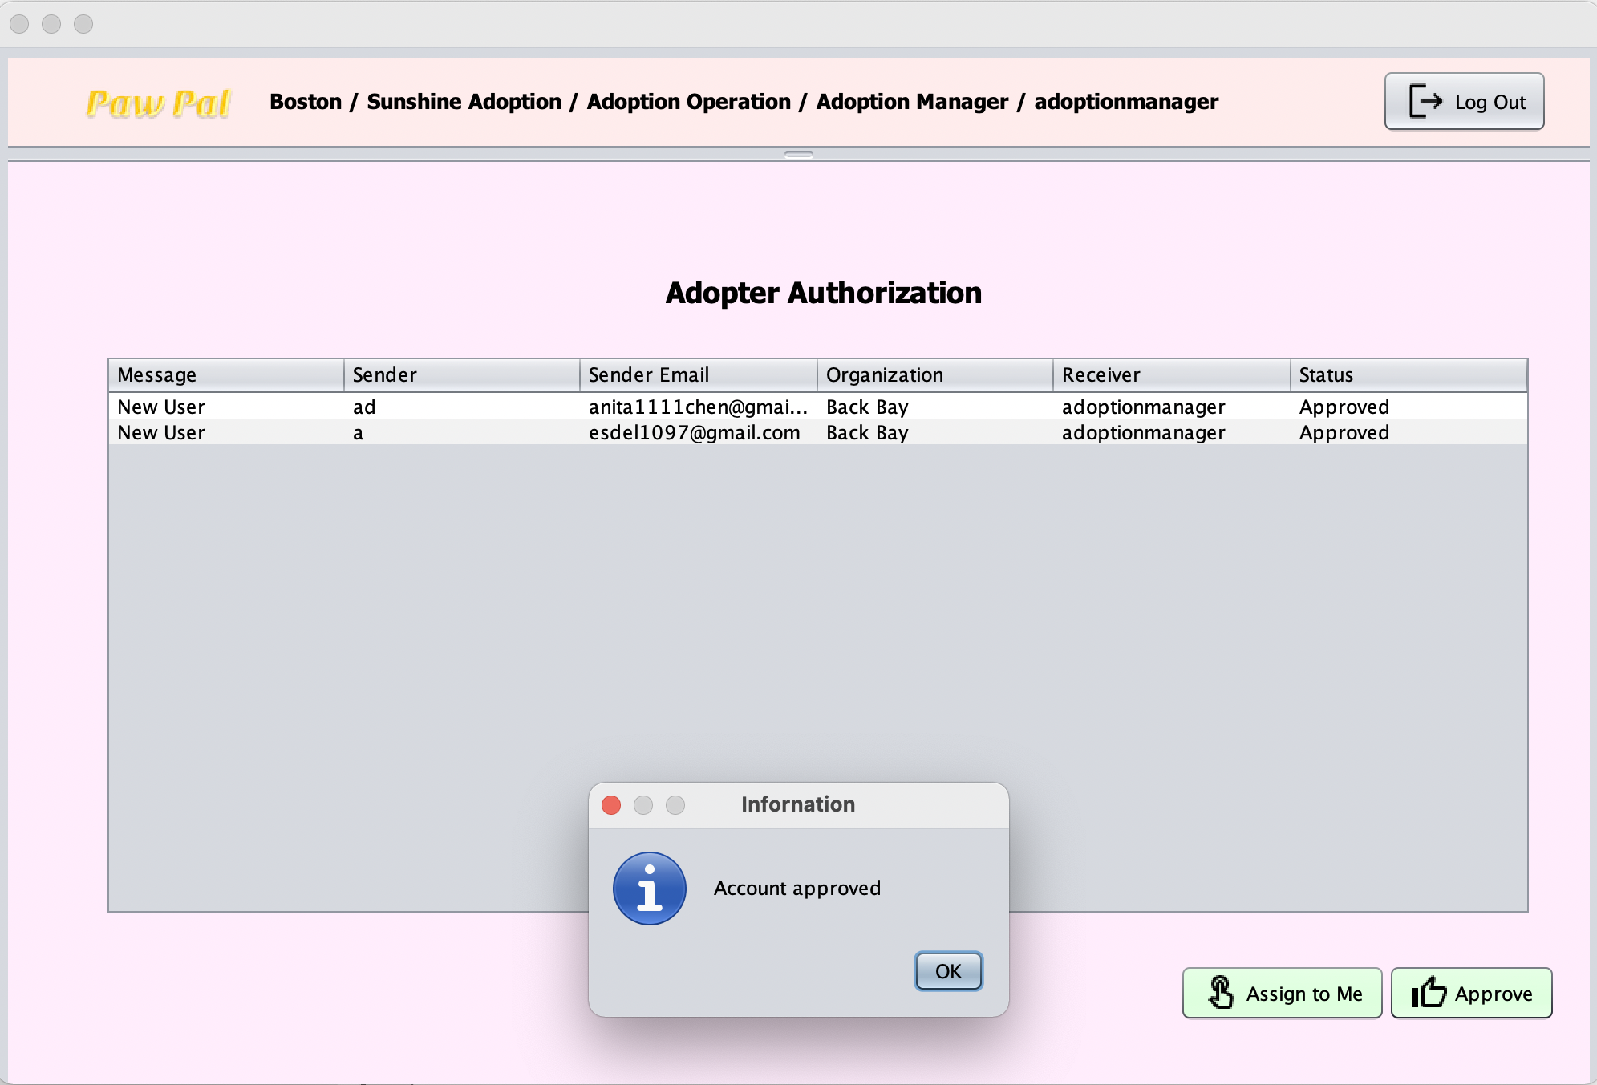
Adoption Manager
Log In
Approve adopter

Slide 28
Thank You

